Slide 1

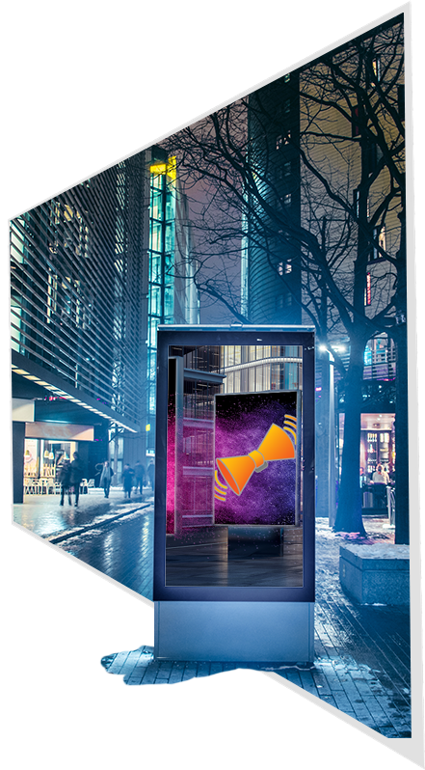
Corporate Announcements
Overview: Features & Functions
July 2019

Slide 2


Overview
Building Corporate Culture
Get Your Message Across
Corporate Announcements
  Interface
  Setup
  Registration
  Resources

Slide 3

Overview
Display ads and announcements on MFP touch-screens throughout the workplace:
  Cycled continuously as a
  screensaver.
  Accessed directly from the MFP’s available Apps.
MFP users can still print, scan, and fax – without interruption!

Slide 4
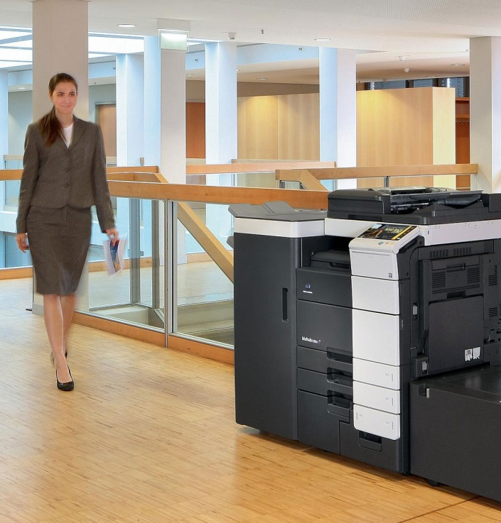
Build Your Company’s Corporate Culture
Take advantage of one of the most frequently visited items in the workplace – the MFP!
Convey important and timely information to your employees.
Add a great visual impact to offices and other corporate spaces.

Slide 5
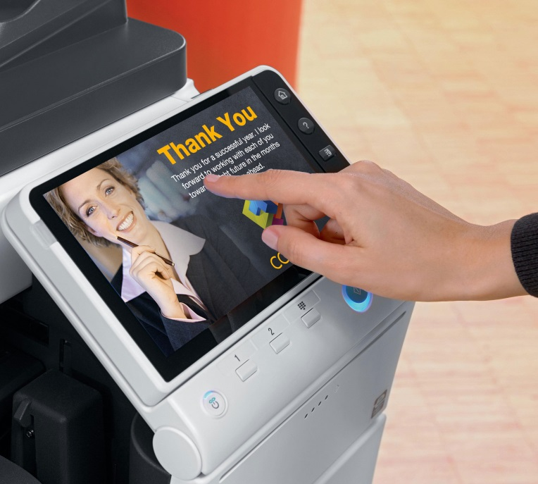
Get Your Message Across
Examples
Hospitals
Display HIPAA security standards, reminders of medical protocols, and public health safety concerns.
Schools
Display announcements about field trips, teacher professional development days, and other events.
Law Firms
Display company messages and mottos, announcements of new clients & major wins.

Slide 6
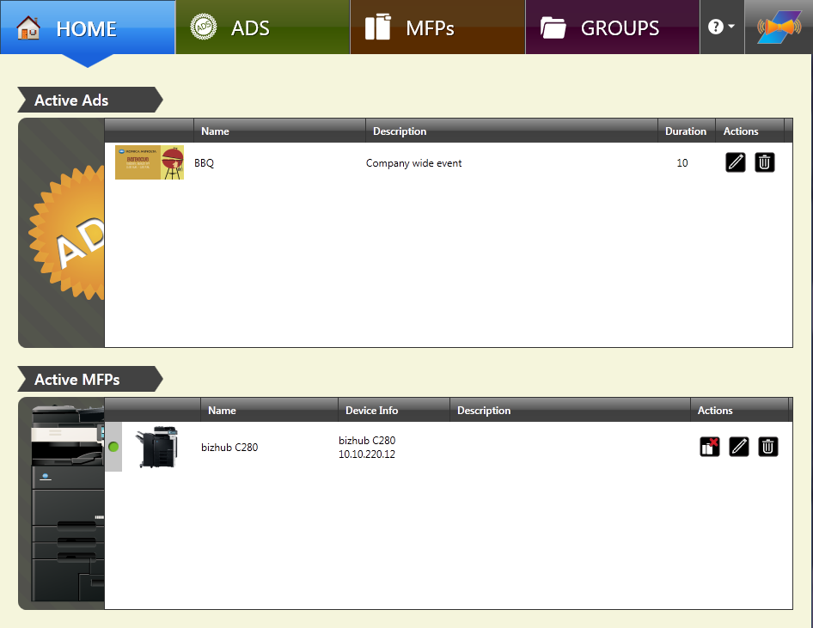
Easy-To-Use Interface
Home screen allows administrators to:
Quickly and easily view current ads with thumbnails and details, including which MFPs are running the ads.
Simple navigation through announcement management and administrative functions, such as MFP Groups.

Slide 7
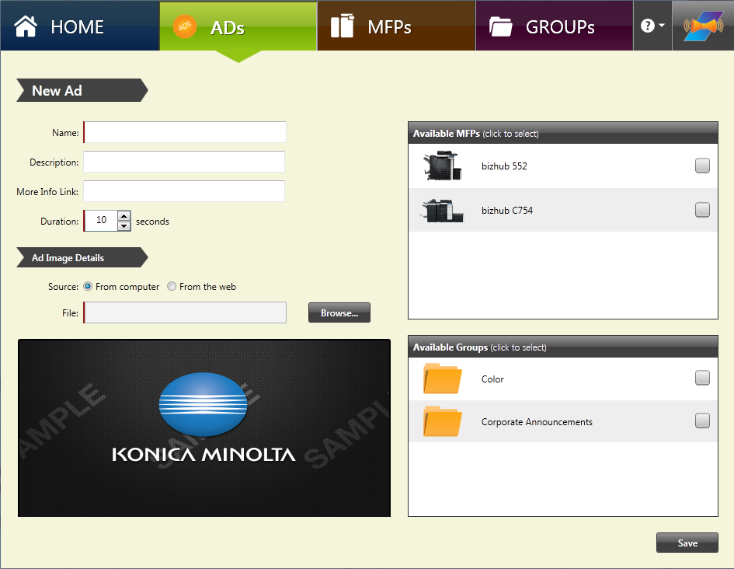
Quick & Easy Setup
#1. DEFINE ADS TO DISPLAY
Specify the duration of time that the ad will display.
Browse for image files on your local computer or remote server.
Images are created in a separate application. The specifications are: PNG, JPG, or GIF, maximum 2 MB file size, and 800 x 480 pixels for best results

Slide 8
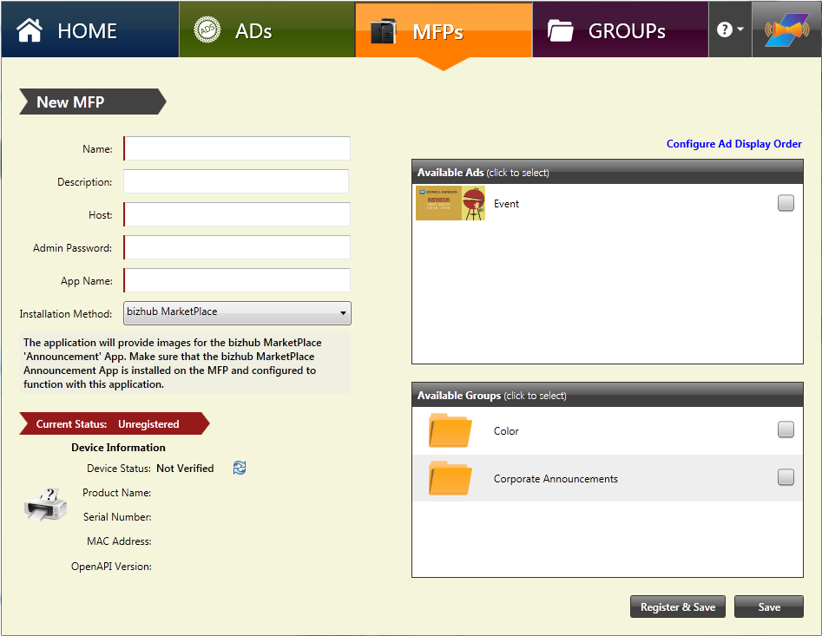
Quick & Easy Setup
#2. DEFINE MFPs THAT WILL DISPLAY THE ADS
Manually enter IP Address or use auto-discover tool.
Choose how ads are delivered to the MFP:
        Through Konica Minolta MarketPlace.
        Uploaded to MFP’s hard drive.
        Pulled from a Web server.

Slide 9
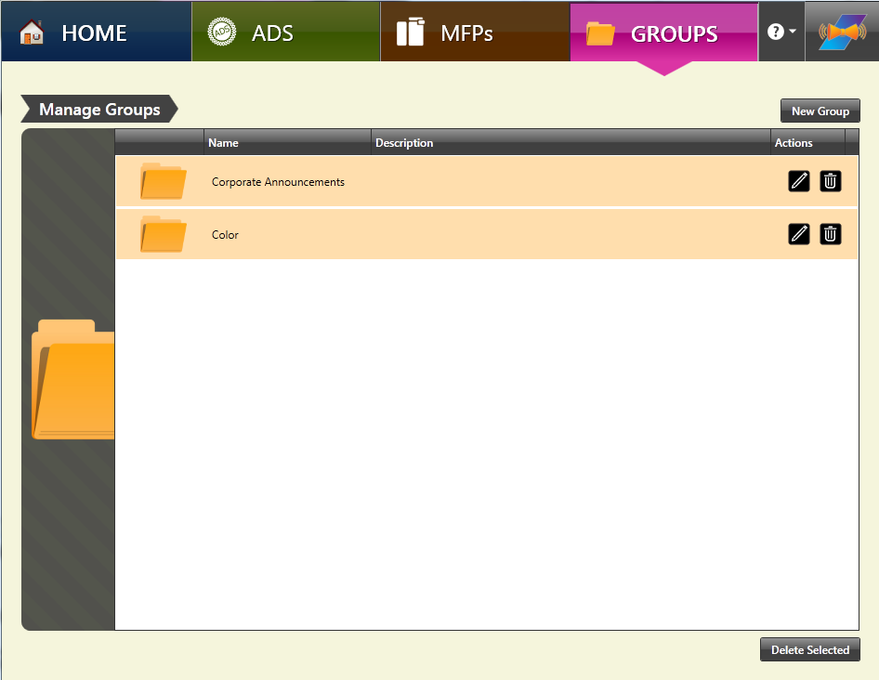
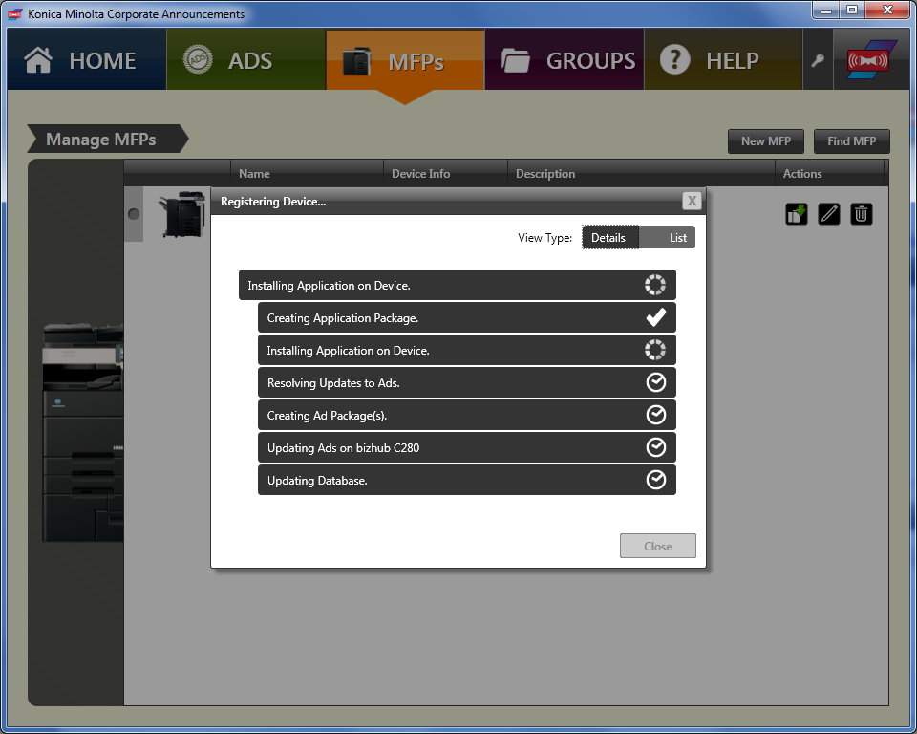
Quick & Easy Setup
#3. ASSOCIATE ADS WITH MFPS
Click on the checkbox next to the ad listed.
#4. CREATE MFP GROUPS (OPTIONAL)
To quickly display ads on multiple MFPs, create an “MFP Group”.
#5. REGISTER APP ON MFP
Installation is quick and easy!

Slide 10
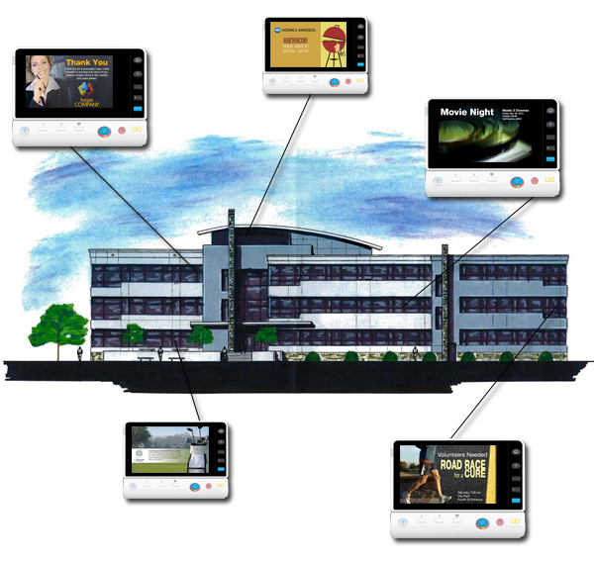
Easy Registration
Full Version. Corporate Announcements application comes with licenses for 5 MFPs.
ADD ONS. To run ads on additional MFPs, register add-ons for 5, 25, 50, 100, 500, 1000 devices.

Slide 11
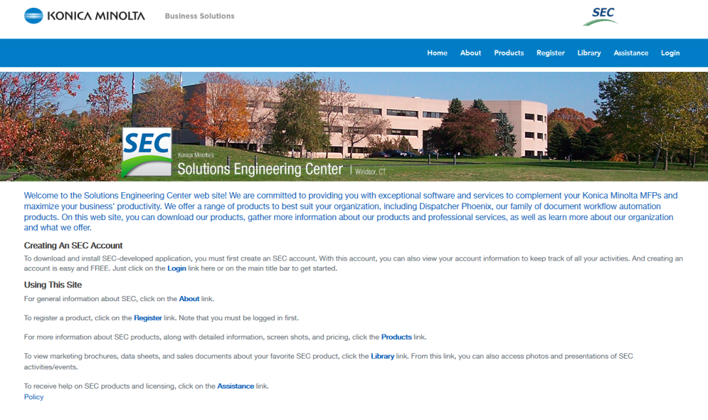
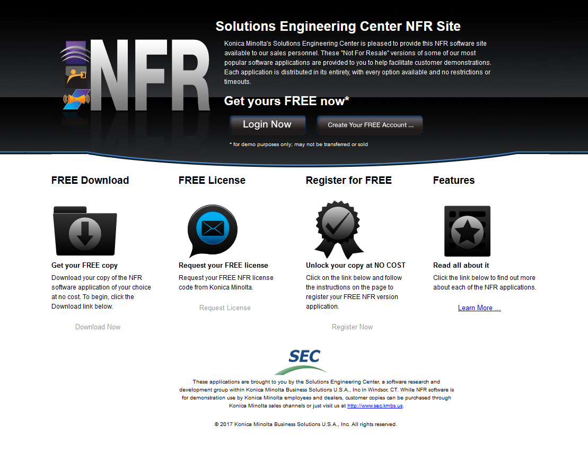
Available For You
For Installation at Customer Location: 30-day Demo versions are available at the Solutions Engineering Center’s web site: www.sec.kmbs.us
For Konica Minolta Employees and Dealer Sales: NFR (Not For Resale) version www.sec.kmbs.us/nfr

Slide 12


Thank You
sec@kmbs.konicaminolta.us

