Slide 1
Government Overview
May 2021

Slide 2
Topics
Overview of Dispatcher Phoenix
Product Overview
Product Key Features
Government-Specific Features
Government-Specific Use Cases for Dispatcher Phoenix
Licensing Information
Resources Available For You

Slide 3
How Can Government Officials Streamline Their Workflow?
Government officials are under constant pressure to:
Handle, manage and protect applications, records, filings, etc. while also dealing with fast-changing regulations for security compliance.
Reduce costs and increase efficiencies to ensure:
Access to information is speedy.
Confidential and sensitive files are secured.
All with no room for document errors!

Slide 4
Drive Change with Dispatcher Phoenix
With Konica Minolta’s Dispatcher Phoenix, local, state and federal government agencies can:
Streamline document workflow & increase efficiencies
Minimize the need for human intervention in redundant and repetitive government processes
Maximize productivity & reduce administrative costs
Provide greater process visibility to identify potential bottlenecks
Capture files automatically
Process and route jobs with ease
Distribute in a single step

Slide 5
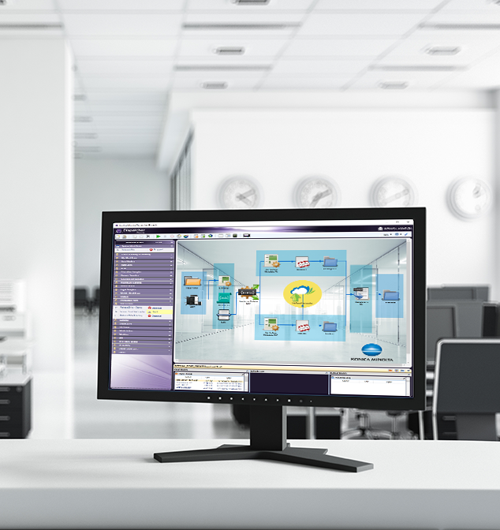
Dispatcher Phoenix is…
Award Winning!
Konica Minolta-developed, award-winning automation solution designed to:
Optimize business processes
Reduce costs
Increase productivity
Drive collaboration
Promote growth and innovation
Received the 2021 ‘ASTORS’ Homeland Security Platinum Award for Best Imaging Technology
Selected as BLI’s 2022 Pick for Outstanding Workflow Automation Platform

Slide 6
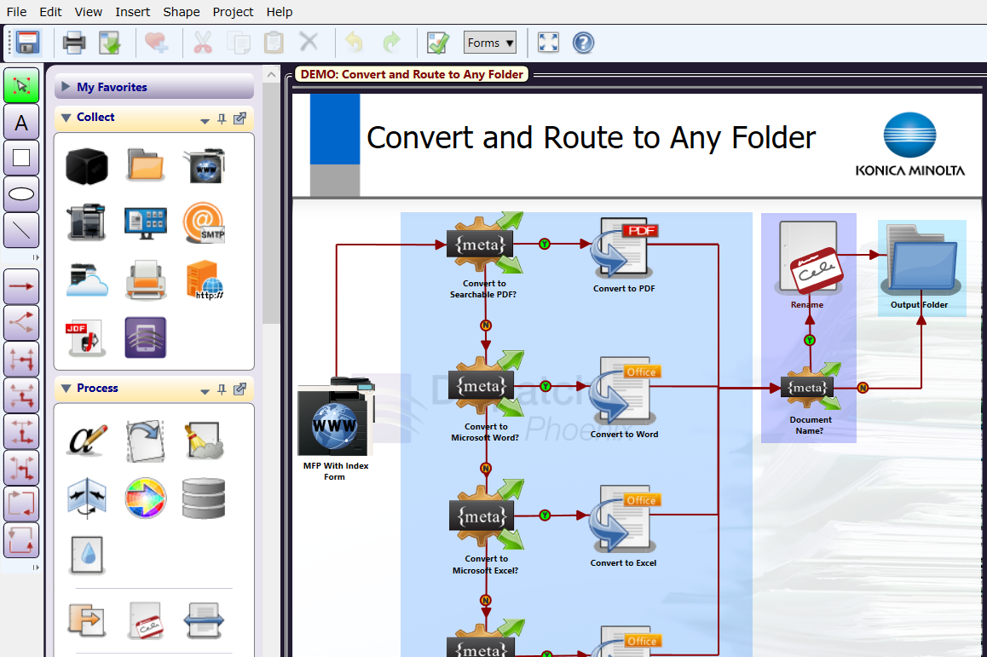
Easily Create and Manage Workflows
Award Winning!
Selected as BLI’s 2020 Pick for Outstanding Workflow Automation Platform
Dispatcher Phoenix’s intuitive Workflow Builder Tool is unique in the market, allowing:
Advanced, customized workflows to be easily created to suit the specific needs of each organization
New users to begin build cost-saving workflows in just minutes
Powerful workflows to be created from scratch or from one of our dozens of pre-built workflows
Easy-to-use features include:
Graphical icons
Drag-and-drop functionality
Drawing tools
Easy to follow validation messages

Slide 7
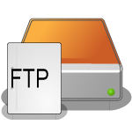
Optimize Workflows with LiveFlo
LiveFlo allows real-time visual observation of documents moving through workflows.
Key features include:
The ability to observe files being processed through running workflows
Easy identification of bottlenecks
Simple optimization of inputs, processes, and outputs

Slide 8
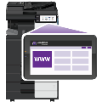
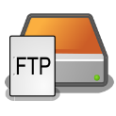
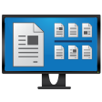
Advanced Capture
Automatically collect documents from a variety of inputs for advanced processing, routing, printing, or storing, including:
MFP
Watched Folder
Email Inbox
Mobile Device
Workstation
Web Capture
FTP Server
Dropbox Folder
LPR Print Queue
Etc.

Slide 9
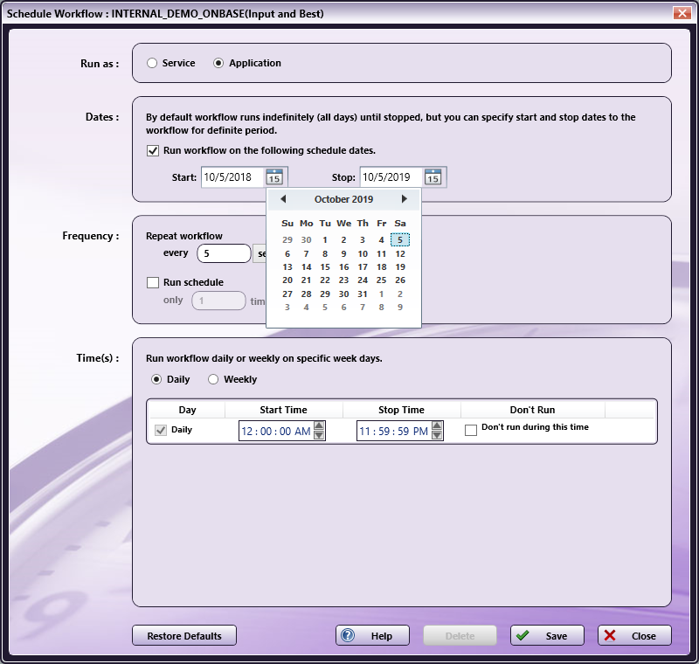
Schedule Workflows to run when you need them!
Award Winning!
Dispatcher Phoenix workflows are highly-customizable and are able to run when they’re most needed. For example, you can:
Specify a day of the week or time of the day, along with a frequency, to ensure workflows complete your automation needs when it’s most convenient for the team
Save valuable time and resources by scheduling high-volume, heavy processing workflows after business hours
Schedule workflows to run as a service continually while the PC is on

Slide 10
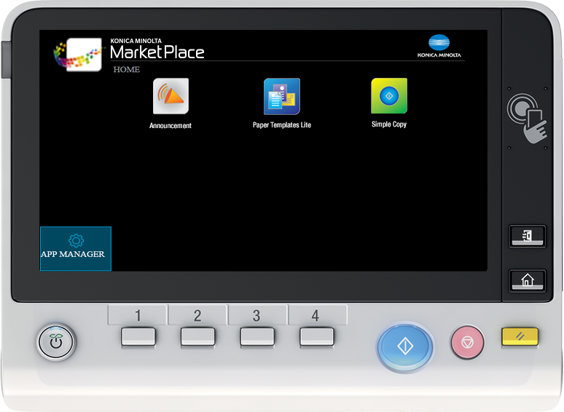
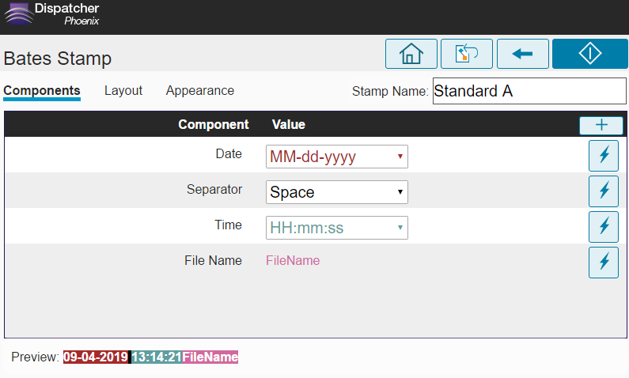
Automated Document Processes
Streamline document processing and reduce time spent on repetitive tasks with Dispatcher Phoenix’s powerful library of process nodes, including:
Advanced Bates Stamp
Advanced OCR
Annotation
Barcode Writer
Convert to Office
Convert to PDF
File Rename
Highlight & Strikeout
ODBC connector
Redact
Watermark
Many more…

Slide 11
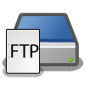
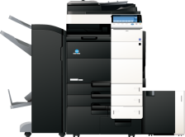
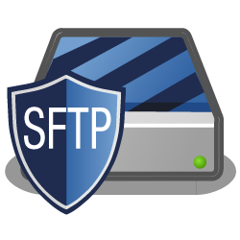
Improve Efficiencies with Intuitive Indexing
Expedite document distribution by automating workflow output of processed files. Popular distribution options include:
Email
Folder on the network or Desktop
FTP Server
Guardian by LawLogix
Laserfiche
OnBase by Hyland
Printer
Production Print Systems
SFTP Server
Windows Fax
Workshare
And More…

Slide 12
Share Documents to Drive Collaboration
Send processed documents to major cloud storage systems with ease.
Simple-to-use cloud connectors incorporate single sign-on to the cloud, so only one login is required!

Slide 13
Powerful Scalability
Create unique, modular cost-effective solutions tailored to changing governmental needs with Dispatcher Phoenix’s enhanced scalability. Optional add-in modules include:
2D Barcode Processing
Advanced OCR
Barcode Processing
Batch Indexing
Copy Defender
Forms Processing
Release2Me for secure print release
Specialized connectors
Much more…

Slide 14
Enhance Document & Data Security
Maintain document security with Dispatcher Phoenix’s built-in information security features:
CAC/PIV Authentication
FIPS 140-2 Compliant Encryption
Automatic File Deletion
Limiting Workflow Access & Audit Trails

Slide 15
Government-Specific Use Cases

Slide 16
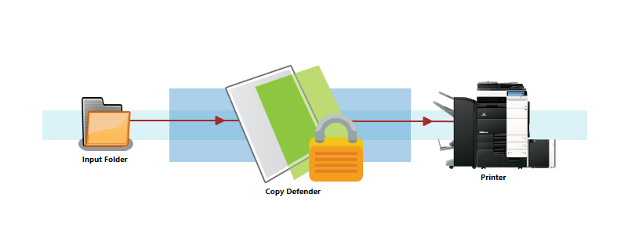
Stop Illegal Copying of Sensitive Documents
Secure government printouts with Dispatcher Phoenix’s Copy Defender node. Automatically protect documents and ensure that:
Security watermarks are automatically applied to printed documents
Copying of documents can be instantly canceled once the Copy Defender security settings are detected
A password is required to be entered before the copy operation can continue

Slide 17
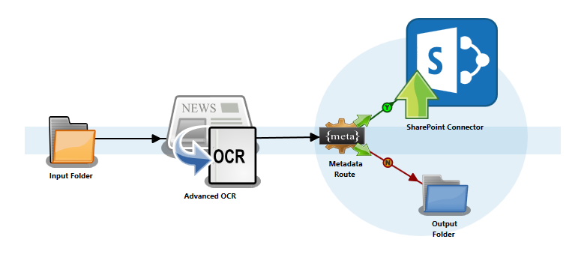
Organize Documents – In a Single Step!
Quickly organize documents with intelligent data extraction and a direct connector to Microsoft SharePoint
Detect and extract important data on scanned documents via OCR zones.
Automatically route documents based on user-defined rules. In this case:
All detected invoices are indexed and stored in SharePoint.
All other documents are stored in a folder on the network.
Additional Direct Connectors to 3rd party document management systems include:
Guardian
Laserfiche
OnBase
Worldox
Workshare
And more!

Slide 18
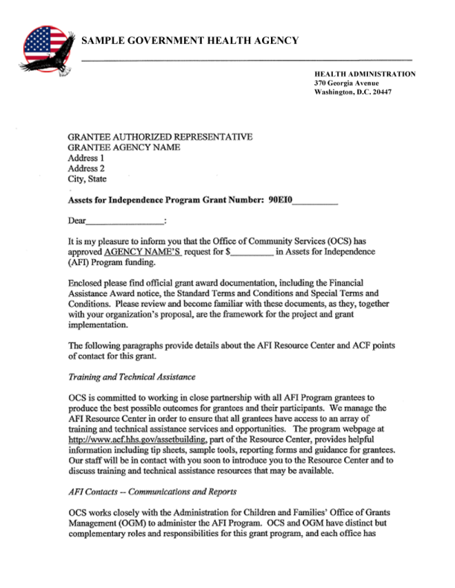
Respond To Privacy Regulations with Automatic Redaction
Eliminate the need for manual redaction operations using pen or mark-up tape! Dispatcher Phoenix includes Highlight, Strikeout, and Redaction capabilities, which allow you to:
Quickly search a document and redact, highlight, or strikeout sensitive information in applications, records, reports, forms, etc.
Customize, create or remove document search terms directly at the MFP
Permanently remove information from government documents including reports, applications, and/or agreements

Slide 19
Streamline Document Handling with Barcode Processing
Take advantage of powerful barcode recognition to classify and process incoming documents. With one simple workflow, incoming policies, reports, and records can be:
Identified based on barcode
Split into separate files
Renamed based on barcode value
Stored in a newly created folder on the network
Dispatcher Phoenix supports a large variety of both Standard and 2D barcodes!

Slide 20
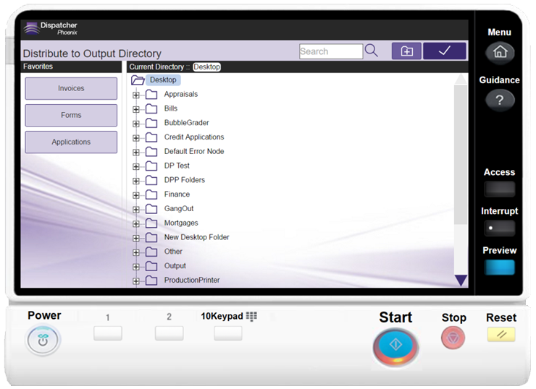
Improved Scanning – Right at the MFP
Improve efficiencies at the MFP with Dispatcher Phoenix’s intuitive, appealing user interface. Government staff can easily:
Select a folder to store applications and other government documents, using a familiar, Windows-like folder structure at the MFP
Look for specific project or initiative folders with type-ahead search ease
Create new folders “on the fly”

Slide 21
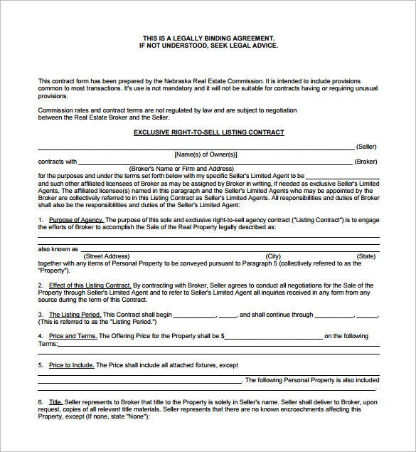
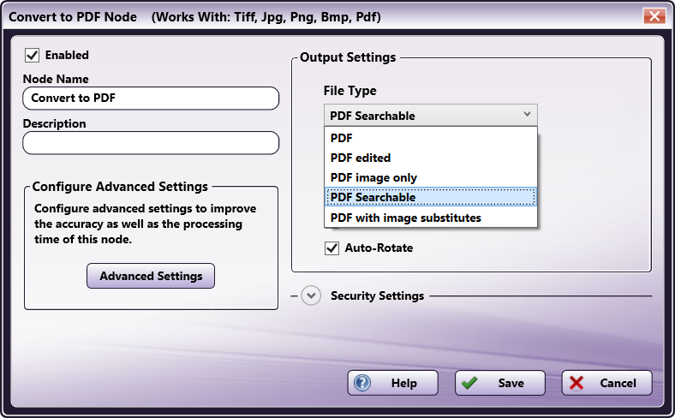
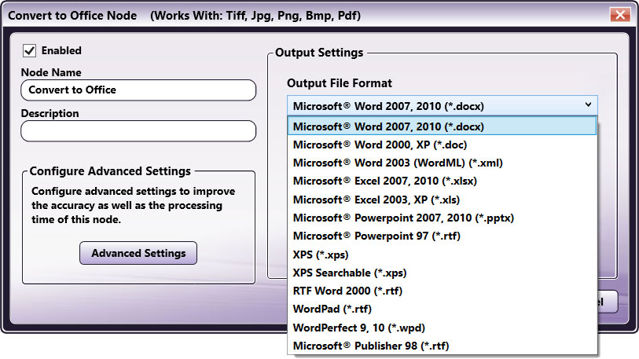
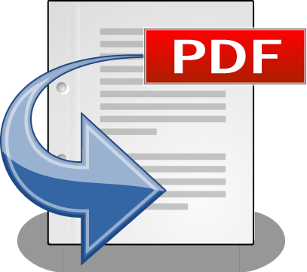
Access Documents – Instantly
Maintain the security and integrity of government documents by automatically converting scanned image files to a variety of PDF formats and Microsoft Office formats, including:
Microsoft Word, Excel, PowerPoint, Rich Text Format, etc. for editing
PDF Searchable for keyword searching
PDF/A for long-term archiving
Set up an automated workflow or choose the file format right at the MFP!

Slide 22
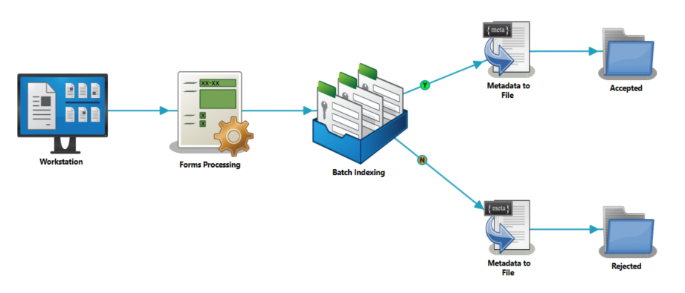
Automated Indexing For Future Retrieval
Easily create electronic files that can be archived and retrieved at a later date with automated indexing! In just minutes, you can:
Set up a Dispatcher Phoenix workflow to automatically index incoming documents based on extracted data, workflow metadata, and more.
Expedite indexing at the MFP panel or Web Interface via database lookups.
Streamlined indexing operations saves time for government office workers!

Slide 23
Licensing

Slide 24
Dispatcher Phoenix’s Government Package
Easily capture, organize, and store important government documents in content management systems, such as Laserfiche. This ECM solution is fully integrated with Dispatcher Phoenix, providing the advanced document capture, processing and routing capabilities that document-intensive organizations need to drive productivity.
Dispatcher Phoenix Features
Collection nodes to collect documents from popular CMSs
Dozens of processing nodes that automate time-consuming manual processes
Distribution nodes to send documents where they need to go instantly
Multiple OCR engines for optimized Ocular Character Recognition
High availability and ongoing support for maximized uptime for your organization
Government Package Features
Barcode Processing w/ OmniPage
Convert to Office w/ OmniPage
Copy Defender
Laserfiche Connector
OmniPage License for Advanced OCR
OmniPage License for Convert to PDF
Redaction/Highlight w/ OmniPage

Slide 25
Resources

Slide 26
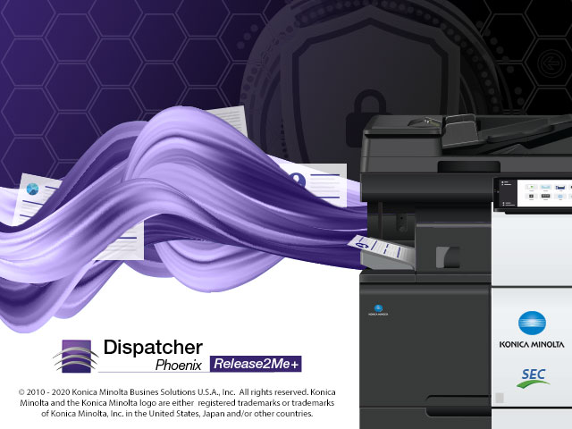
A Powerful Family of Solutions
Licenses
Dispatcher Phoenix - Our award-winning flagship product for simple
Dispatcher Phoenix ScanTrip – Our powerful scan-to-cloud solution
Dispatcher Phoenix Release2Me+ – Our cost-effective, secure print release solution
Vertical Packages
ECM
Education
Finance
Government
Healthcare
Legal
Office

Slide 27
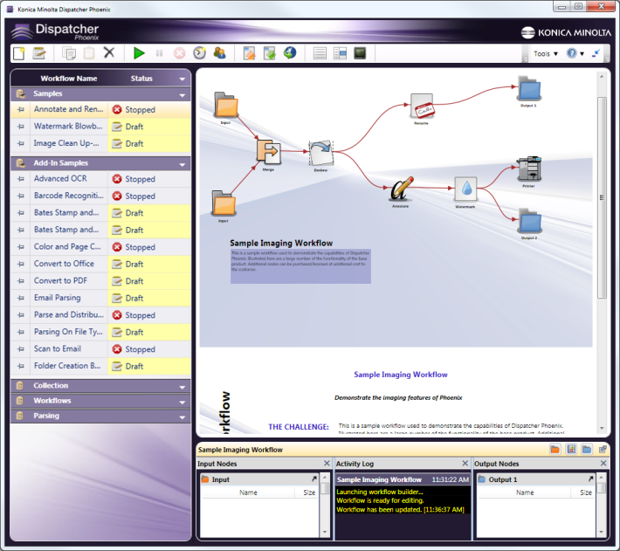
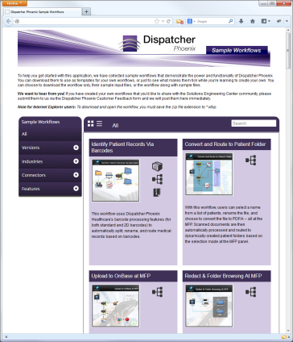
Get Started Quickly
Dispatcher Phoenix comes with a library of pre-configured workflows and templates, which can help you start using the product to its maximum potential quickly and easily.
Fully-configured sample workflow templates include:
Description of use case (challenge, solution, benefits)
Sample input files
Examples of fully-configured Government workflows include:
Search and Scan to Guardian
Extend Document Safety with SFTP
Convert and Upload to Laserfiche
Scan to Me
Protect Documents from Unauthorized Copying
And more!
Easy-to-learn and perfect for first-time users!

Slide 28
Resources Available to You
Demo Licenses
Fully-functional 30-day demo licenses of Dispatcher Phoenix
Download today from sec.kmbs.us
Marketing Collateral
Dispatcher Phoenix Brochures for Government
Dispatcher Phoenix Brochures for all other Vertical Markets & Individual Connectors
Dispatcher Phoenix Battle Cards
Videos
MFP Simulator
Web-based and Instructor-led training
Government Package Battlecards
Download today from MyKonicaMinolta.com
Other Resources
NFR Licenses for Demo Rooms: sec.kmbs.us/nfr
Online help: docs.dispatcher-phoenix.com/
Comprehensive online documentation & solution walk-through
Intuitive, autocomplete search capabilities

Slide 29
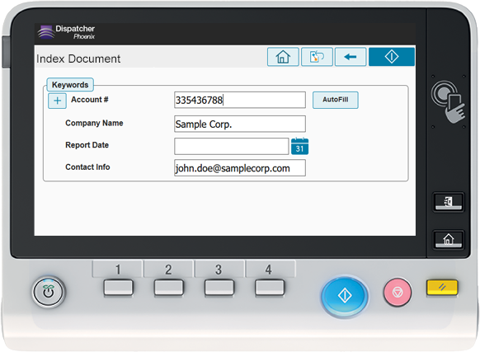
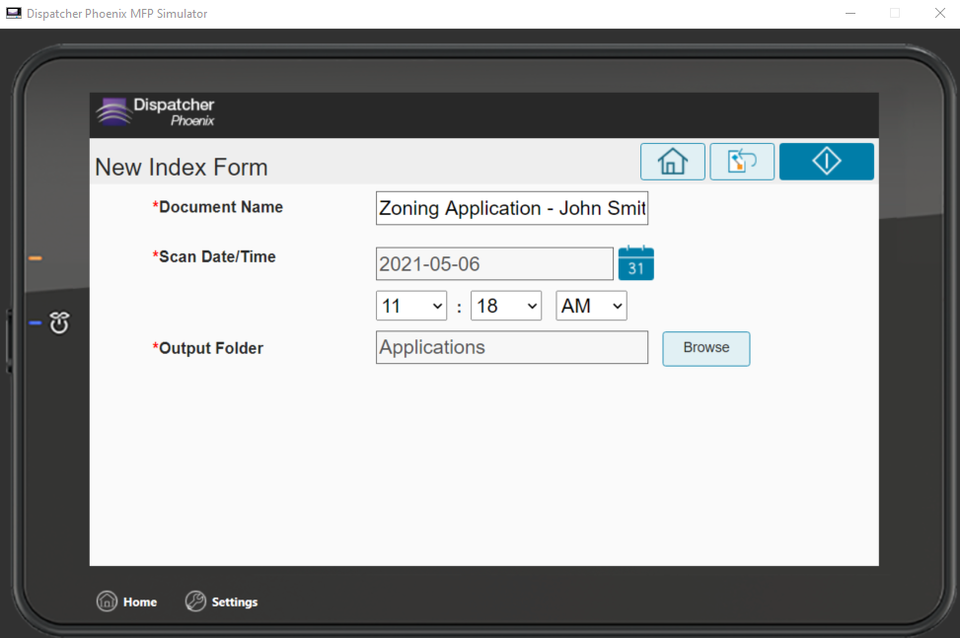
MFP Simulator
The Dispatcher Phoenix MFP Simulator gives you a view of the application’s “look and feel” on the MFP and does not require Dispatcher Phoenix or a physical MFP. It is currently available as:
A stand-alone, PC-based Simulator
An online, web-based Simulator that can be used on PC browsers, iPhones, iPads, Android devices, and other mobile devices
An integrated Simulator within Dispatcher Phoenix
Experience the power of Dispatcher Phoenix!

Slide 30
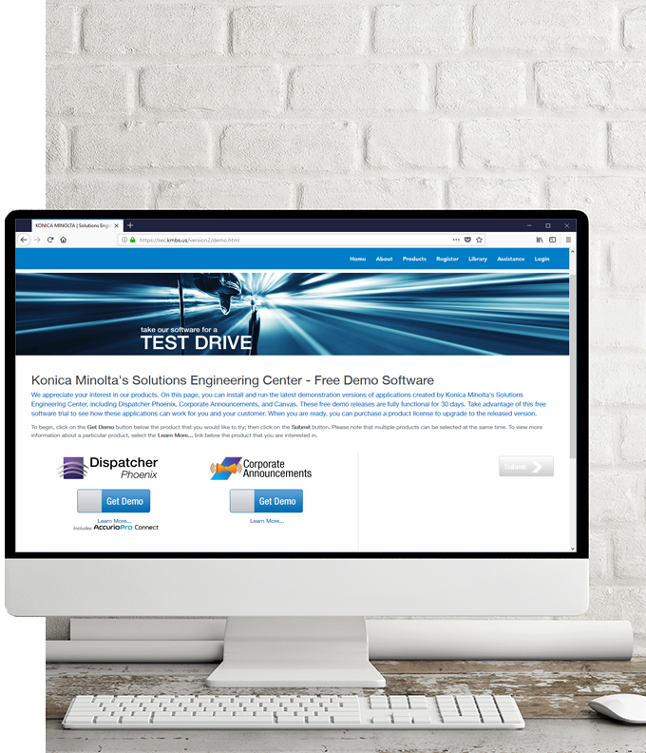
Helping You and Your Customers
SEC PRESALES SUPPORT
Review of customer requirements
Participate in discovery calls
Create Proofs of Concept for customer demos
Conduct demos of Dispatcher Phoenix features and functions
SEC POST-SALES SUPPORT
Professional Services
Remote Installation Services
Requires Business Needs Analysis

Slide 31
Thank You
sec@kmbs.konicaminolta.us

