Slide 1

Dispatcher Phoenix 8.0
Licensing
July 2022

Slide 2

Dispatcher Phoenix
Licensing
Dispatcher Phoenix 8.0 Licensing Model
Slides 3 - 13
Optional Vertical Market Packages
Slides 14 – 16
Term Licensing
Slides 17 - 19
User Licensing
Slides 20 - 25
Release2Me Device Licensing
Slides 26 – 29
Dispatcher Phoenix Enterprise Licensing
Slides 30 - 34
Dispatcher Phoenix ScanTrip
Slides 35 - 40
Dispatcher Phoenix Release2Me+
Slides 41 – 45
Dispatcher Suite Licensing
Slides 46 - 50

Slide 3
Dispatcher Phoenix Product Overview
Dispatcher Phoenix License with Optional Packages/Nodes available
Dispatcher Phoenix
Separate Licenses
Dispatcher Phoenix
License
Dispatcher Phoenix
ScanTrip
Dispatcher Phoenix
Release2Me+
Vertical market packages can be added to the Dispatcher Phoenix base license for a one-time fee
Optional modules can be added to the Dispatcher Phoenix base license for a one-time fee
Enterprise license (flat fee) for failover
Upgrade Path:
Dispatcher Phoenix ScanTrip customers can upgrade directly to a fully Dispatcher Phoenix license, if needed.
More information is available here.
Dispatcher Phoenix Release2Me+ customers will be able to upgrade their license to a full Dispatcher Phoenix license with a custom quote via SEC Consulting Services

Slide 4

Included with the Dispatcher Phoenix license…
  Collection Nodes
  DP Mobile
  Dropbox In
  FTP In
  Google Cloud Print
  Input Folder
  LPR In
  MFP Panel
  MFP User Box
  Web Capture
  Processing Nodes
  Advanced OCR
  Annotate
  Color Route
  Convert to PDF
  Convert to PS
  Deskew
  Despeckle
  Insert
  Merge
  Metadata to File
  Metadata Routing
  Metadata Scripting
  Mirror Image
  Negative Image
  ODBC
  Page Count Route
  Parse & Distribute
  Parse & Insert
  Parse & Replace
  Parser
  PDF Metadata Extraction
  PJL Print Preferences
  Print to File
  Rename
  Split
  Watermark
  Distribution Nodes
  Box Connector
  Dropbox Connector
  FilesAnywhere Connector
  FileAssist Connector
  FTP Out
  Google Drive Connector
  Microsoft Exchange Connector
  OneDrive Connector
  OneDrive for Business Connector
  Output Folder
  Printer
  SFTP Out
  SharePoint Connector
  SharePoint Online Connector
  SMTP Out
  WebDAV Connector
A more full featured and comprehensive workflow automation license with OCR!

Slide 5


Dispatcher Phoenix OCR Licensing
The Dispatcher Phoenix Base license now includes the Advanced OCR & Convert to PDF nodes! These nodes support the Tesseract OCR Engine.
Customers can upgrade their OCR license with Kofax OmniPage!
DP OmniPage license for Convert to PDF
DP OmniPage license for Advanced OCR
If multiple OCR Engines are licensed, the user will be able to select their preferred OCR Engine during configuration.
Advanced OCR & Convert to PDF

Slide 6
Dispatcher Phoenix Perpetual License
Dispatcher Phoenix provides a stackable license that is purchased for each unique capture source.
  A unique capture source is any point of entry into a running or scheduled workflow. Unique capture sources are counted based upon the nodes requirements.
The software required to run Dispatcher Phoenix is included with each base license and this license includes all basic workflow automation functionality with no limits on page volume processing.
Standard 1, 3, 5 Year Maintenance terms as well as Gold SLA options are available.
Volume ranges are available for point of purchase discounts for quantities of 10 or more licenses.
Dispatcher Phoenix Volume Ranges
Dispatcher Phoenix (1-9 Active Inputs)
Dispatcher Phoenix (10-49 Active Inputs)
Dispatcher Phoenix (50-199 Active Inputs)
Dispatcher Phoenix (200+ Active Inputs)

Slide 7
How are Dispatcher Phoenix Licenses Counted?
A unique capture source is a point of entry into a running or scheduled workflow (ex. 1 MFP, 1 Web Capture Device, 1 Input Folder).
Unique capture sources are counted by:
A workflow can have one or many capture sources.
  ^{Dropbox In}
  Collect files from a folder in Dropbox.
  ^{Email In}
  Collects files from Email Folders.
  ^{FTP In}
  Collects files from FTP Servers.
  ^{Google Cloud Print}
  Receives Google Cloud print jobs.
  ^{HTTP In}
  Receives documents that are uploaded
  ^{through a web service.}
  ^{Input Folder}
  Collects from local or network folders
  ^{JDF Converter}
  Parses information from JDF file.
  ^{LPR In}
  Collects print jobs from an LPR Client like the Windows Printer Queue.
  ^{MFP Panel}
  Allows you to initiate workflows directly from
  ^{an MFP using bEST technology.}
  ^{MFP User Box}
  ^{Collects from MFP User Boxes}
  ^{SMTP In}
  Receives emails sent from an MFP.
  ^{Google Cloud Print}
  Receives Google Cloud print jobs.
  ^{Web Capture}
  ^{Capture documents from}
  ^{any device via a web browser.}
Input Node | Folder Path | Host Name | IP Address | Print Queue | URL
Dropbox In | ✓ | - | - | - | -
Email In | - | ✓ | ✓ | - | -
FTP In | ✓ | ✓ | ✓ | - | -
Google Cloud Print | - | - | - | ✓ | -
HTTP In | - | - | - | - | ✓
Input Folder | ✓ | - | - | - | -
JDF Converter | ✓ | - | - | - | -
LPR In | - | - | - | ✓ | -
MFP Panel | - | ✓ | ✓ | - | -
MFP User Box | - | ✓ | ✓ | - | -
SMTP In | - | ✓ | ✓ | - | -
Web Capture | - | ✓ | ✓ | - | -

Slide 8
Dispatcher Phoenix SLA Information
For Dispatcher Phoenix, there are options for both standard maintenance and Gold SLA support.
Dispatcher Phoenix Standard Maintenance Options
Dispatcher Phoenix (1-9 Active Inputs) 1 Year Maintenance
Dispatcher Phoenix (1-9 Active Inputs) 3 Year Maintenance
Dispatcher Phoenix (1-9 Active Inputs) 5 Year Maintenance
Dispatcher Phoenix (10-49 Active Inputs) 1 Year Maintenance
Dispatcher Phoenix (10-49 Active Inputs) 3 Year Maintenance
Dispatcher Phoenix (10-49 Active Inputs) 5 Year Maintenance
Dispatcher Phoenix (50-199 Active Inputs) 1 Year Maintenance
Dispatcher Phoenix (50-199 Active Inputs) 3 Year Maintenance
Dispatcher Phoenix (50-199 Active Inputs) 5 Year Maintenance
Dispatcher Phoenix (200+ Active Inputs) 1 Year Maintenance
Dispatcher Phoenix (200+ Active Inputs) 3 Year Maintenance
Dispatcher Phoenix (200+ Active Inputs) 5 Year Maintenance
Dispatcher Phoenix Gold SLA Options
Dispatcher Phoenix (1-9 Active Inputs) 1 Yr Gold SLA
Dispatcher Phoenix (10-49 Active Inputs) 1 Yr Gold SLA
Dispatcher Phoenix (50-199 Active Inputs) 1 Yr Gold SLA
Dispatcher Phoenix (200+ Active Inputs) 1 Yr Gold SLA
DP Office Package 1 Yr Gold SLA
DP Legal Package 1 Yr Gold SLA
DP Government Package 1 Yr Gold SLA
DP Healthcare Package 1 Yr Gold SLA
DP Education Package 1 Yr Gold SLA
DP Finance Package 1 Yr Gold SLA
DP ECM Package 1 Yr Gold SLA
*Note: There are standard maintenance and Gold SLA item numbers available for all Dispatcher Phoenix Licenses and optional modules. See the price book for a full list of maintenance options.

Slide 9
Dispatcher Phoenix Maintenance Activation & Expiration
A maintenance period automatically starts when the order is processed. There is no dependency on license activation.
New Dispatcher Phoenix maintenance licenses will always include a grace period until the end of following month from the day of order fulfillment. Depending on the date that the order is processed, a customer is granted an additional grace period of anywhere between 30 and 60 days.
Here are some examples:
Order Date | Maintenance Term | License Expiration | Grace Period
May 25, 2022 | 1 Year | June 30, 2023 | 35 days
June 1, 2022 | 1 Year | July 31, 2023 | 60 days
June 1, 2022 | 3 Year | July 31, 2025 | 60 days
June 15, 2022 | 1 Year | July 31, 2023 | 45 days
June 15, 2022 | 5 Year | July 31, 2027 | 45 days

Slide 10
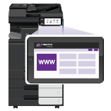



Example: 5 Dispatcher Phoenix Licenses
1st Example: 1 workflow with 5 MFP Panel nodes. Each MFP Panel node is collecting documents from a single KM device, identified by the device’s IP address. In this case, 5 licenses are used.
12.34.56.78
89.23.25.45
56.85.96.39
98.76.54.32
56.48.59.23

Slide 11
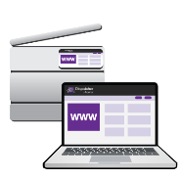

Example: 3 Dispatcher Phoenix Licenses
2nd Example: 1 workflow with 3 Web Capture nodes. Each Web Capture node is collecting documents from a single device such as a mobile phone, laptop, tablet, etc., identified by the device’s IP address. In this case, 3 licenses are used.
10.30.40.50
10.30.40.60
10.30.40.80

Slide 12

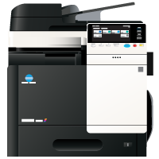

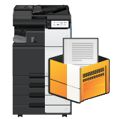
Example: 1 Dispatcher Phoenix License
3rd Example: 1 workflow with an SMTP In node, MFP User Box node, and MFP Panel node – all collecting from the SAME device identified by the IP Address. In this case 1 license is used.
12.34.56.78
12.34.56.78
IP Address: 12.34.56.78
1 Active Input
All input methods reside on same MFP, so only 1 Active Input required
12.34.56.78

Slide 13








Example: 3 Dispatcher Phoenix Licenses
4th Example: In this example there are 5 inputs - 2 use the same MFP (IP address) meaning 4 total licenses are counted.
12.34.56.78
C:\Documents\New
12.34.56.78
10.20.30.40
C:\Reports\Monthly

Slide 14
Vertical Market Packages

Slide 15
Dispatcher Phoenix Vertical Packages
Providing a holistic solution for our vertical-market customers.
Optional packages are available to add on top of Dispatcher Phoenix license:
  Office, Legal, Government, Healthcare, Education, Finance, and ECM.
1, 3, 5 Year Maintenance terms are available.
All maintenance and any additional active inputs have been removed from packages.
Optional Packages are licensed per server, not per Active Input license. For example:
To run DP + DP Office optional package on 5 MFPs, you would need:
  Five (5) DP licenses using the 1-9 range.
  (1) DP Office optional package.

Slide 16
Vertical Market Optional Packages
  Office Features
  Government Features
  Convert to Office w/ OmniPage
  OmniPage license for Convert to PDF
  OmniPage license for Advanced OCR
  Asian Font Pack
OmniPage License for Advanced OCR
Barcode Processing w/ OmniPage
Convert to Office w/ OmniPage
Redaction/Highlight w/ OmniPage
OmniPage License for Convert to PDF
Copy Defender
Laserfiche Connector
  Healthcare Features
Email Bundle
OmniPage License for Advanced OCR
Barcode Processing (1D) w/ OmniPage
Barcode Processing (2D) w/ OmniPage
Convert to Office w/ OmniPage
Redaction/Highlight w/ OmniPage
OmniPage License for Convert to PDF
CDA Generator
Rx Shield
HL7 Connector
OnBase Connector
  Legal Features
Advanced Bates Stamp
OmniPage license for Convert to PDF
Redaction / Highlight w/ OmniPage
Guardian Connector
  Finance Features
  ECM Features
OmniPage License for Advanced OCR
Convert to Office w/ OmniPage
OmniPage License for Convert to PDF
Barcode Processing (1D) w/ OmniPage
Barcode Processing (2D) w/ OmniPage
Redaction/Highlight w/ OmniPage
Advanced Bates Stamp
OmniPage License for Convert to PDF
Email Bundle
OmniPage License for Advanced OCR
Convert to Office w/ OmniPage
Barcode Processing
(1D & 2D) w/ OmniPage
Redaction /Highlight w/ OmniPage
OnBase Connector
Forms Processing
Copy Defender
Release2Me
10 Mobile Users
Workstation (1 User)
Batching Indexing
(1 User)
  Education Features
OmniPage License for Advanced OCR
Convert to Office w/ OmniPage
OmniPage license for Convert to PDF
Redaction/Highlight w/ OmniPage
Bubble Grader

Slide 17
Dispatcher Phoenix Term Licensing

Slide 18
At a Glance…
Dispatcher Phoenix term licenses offer the same functionality as standard Dispatcher Phoenix perpetual licenses.
Maintenance and support is included as part of the term license.
The cost of a 12-month term license must be paid upfront and then paid yearly.
With Dispatcher Phoenix term licenses, customers can invest in the functionality that they need now and also continue to expand their capabilities as their organization grows.
DP Perpetual Licenses | DP Term Licenses
Software is installed on server / local computer. | Software is installed on server / local computer.
Maintenance sold separately. | Maintenance included as part of subscription/term license.
Customer owns the software. | Customer does not own their license(s).
One-time fee paid up-front. | 12-month subscription paid up-front.
Software remains available even if maintenance is not renewed. | Software no longer works if subscription/term is not renewed.
Priced higher than subscription plan due to continuous license. | Price lower than perpetual license due to short-term commitment.

Slide 19
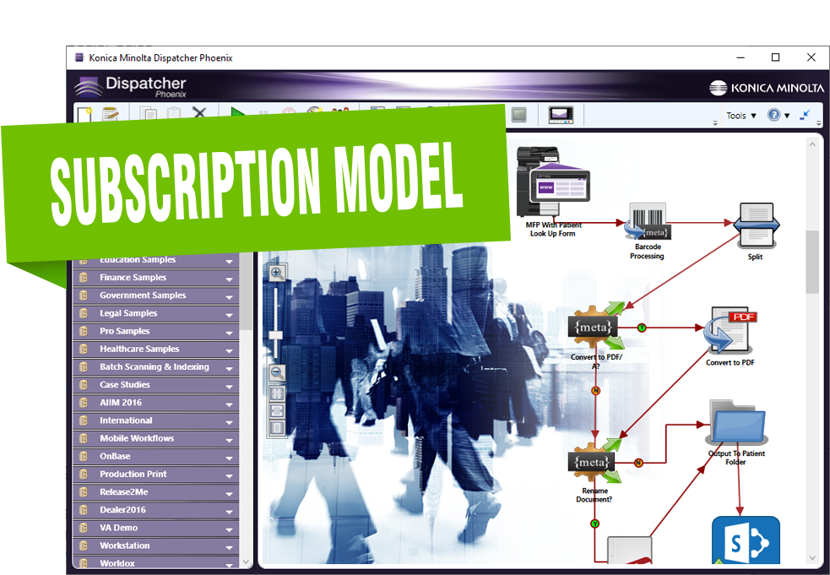
Ordering Term Licenses
When ordering, please note the following:
  ALL Dispatcher Phoenix monthly term licenses must be ordered in 12-month increments.
  Multiple base licenses must be ordered as separate line items.
  A note should be included on the order that the software will be installed on a new system.
  All items should be ordered with the same kind of maintenance (Regular maintenance or Gold SLA).

Slide 20
Dispatcher Phoenix User Licensing
Workstation, Batch Indexing, & Mobile

Slide 21



User Licensing
The following Dispatcher Phoenix features are licensed by named user:
Dispatcher Phoenix Mobile
(10, 25, 50, 100, 250, 500 & 1000 User Packs)
Dispatcher Phoenix Workstation
(1 User License & 10 User Packs)
Dispatcher Phoenix Batch Indexing Package
(1 User License & 10 User Packs)
Note: Workstation and Batch Indexing User Licenses include all the functionality necessary to operate those features.

Slide 22
Dispatcher Phoenix Workstation
Dispatcher Phoenix Workstation is a dedicated scan station that supports any manufacturer’s high-speed TWAIN scanning devices. Workstation features the following:
Real-time image display
Auto separation
Scanned image manipulation including:
  Drag-and-drop image reordering
  Split
  Merge
  Point-and-click rescan
  And more!
Dispatcher Phoenix Workstation provides a comprehensive batch scanning solution that is completely integrated with the Dispatcher Phoenix application. Once batches have been received and manually manipulated within the Workstation, an automated Dispatcher Phoenix workflow can process them further and/or store them in the appropriate document management system.

Slide 23
Workstation Licensing
User Licenses are stackable on top of the Dispatcher Phoenix Workstation license in quantities of 1 or 10 licenses.
A single workstation license allows 1 user to scan from their desktop or TWAIN device.
1, 3, 5 Year Maintenance terms are available.
For 5 employees to scan documents via Workstation you would need to add 5 Workstation User Licenses to your Dispatcher Phoenix install:
Licenses | Qt.
Dispatcher Phoenix Workstation (with 1 User License) | 1
Dispatcher Phoenix Workstation 1 Additional User License | 4
Dispatcher Phoenix Workstation (with 1 User License) Software Maintenance (1 yr.) | 1
Dispatcher Phoenix Workstation 1 Additional User License Software Maintenance (1 yr.) | 4

Slide 24
Dispatcher Phoenix Batch Indexing
Dispatcher Phoenix Web’s Batch Indexing app allows users to index their documents before storing them in a document management system for search and retrieval purposes later. Dispatcher Phoenix supports manual indexing using shortcut keys. In addition, index fields can also be pre-populated with data via OCR extraction and database lookups.
The Batch Indexing Package includes:
Batch Indexing Node
Verification Node
1 User License
Reporting
Batch Manager

Slide 25
Batch Indexing Licensing
User Licenses are stackable on top of the Dispatcher Phoenix Batch Indexing Package in quantities of 1 or 10 licenses.
A single Batch Indexing license allows 1 user to access the Batch Indexing and Management tools in Dispatcher Phoenix Web.
1, 3, 5 Year Maintenance terms are available.
For 5 employees to Batch Index documents within Dispatcher Phoenix Web, you would need to add 5 Batch Indexing User Licenses to your Dispatcher Phoenix install:
Licenses | Qt.
DP Batch Indexing Package (with 1 User License) | 1
Dispatcher Phoenix Batch Indexing 1 Additional User License | 4
DP Batch Indexing Package (with 1 User License) Software Maintenance (1 yr) | 1
Dispatcher Phoenix Batch Indexing 1 Additional User License Software Maintenance (1 yr.) | 4

Slide 26
Dispatcher Phoenix Release2Me
Secure Print Release Licensing for Dispatcher Phoenix

Slide 27
Release2Me Device Licensing
The following Release2Me device licenses are optional add-in modules for the Dispatcher Phoenix Base License:
Options
DP Release2Me 1 Device License
DP Release2Me 3 Device License
DP Release2Me 5 Device License
DP Release2Me 10 Device License
DP Release2Me 25 Device License
DP Release2Me 50 Device License
DP Release2Me 100 Device License
DP Release2Me 500 Device License
Release2Me Device licenses can be added to enable secure print release on any Konica Minolta MFPs.
Release2Me Device licenses include ALL Release2Me functionality, including Print Reporting and Print Delegation.

Slide 28
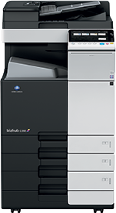

Example: Release2Me on 4 Devices
Active Inputs can be used for scanning AND releasing print jobs.
For example:
Active Input
Device License
Device License
Device License
        A customer with 4 devices can use 1 Dispatcher Phoenix License + 3 Release2Me Device Licenses to enable secure print release on all 4 devices. In addition, with this configuration, the customer will be able to scan into a Dispatcher Phoenix workflow via a single device.

Slide 29
Example: Release2Me using Active Inputs
A customer has 4 Dispatcher Phoenix Licenses and wants to enable secure print release on 5 Konica Minolta Devices
Active Input
Active Input
Active Input
Active Input
Device License
        To enable secure print release on ALL 5 devices, they will need to purchase ONE Dispatcher Phoenix Release2Me device license. The device license will enable all Release2Me functionality across the platform, including the system workflow, Print Delegation and Print Reporting, while also allowing for secure print from one additional device.

Slide 30
Dispatcher Phoenix Enterprise Licensing

Slide 31

Planning for an Enterprise Installation
To properly plan for an enterprise-wide deployment of Dispatcher Phoenix, you must:
Identify your customer goals.
How will they use Dispatcher Phoenix? What additional features will they use in the future? How many devices do they use?
Identify their high availability requirements.
Do they require failover capabilities? Do they need to eliminate a single point of failure? Are they looking for optimal performance via offloading?
Understand the proper architecture for the deployment.
Once you understand how your customer will be using Dispatcher Phoenix and what features they need to use, then you can determine the proper architecture for the deployment.
Have questions? Email sec@kmbs.konicaminolta.us!

Slide 32
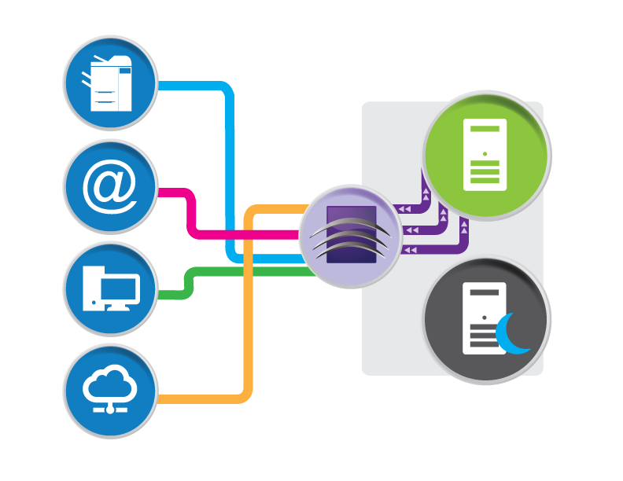
Enterprise Licensing
Dispatcher Phoenix offers enterprise-level features to keep your information flowing, maximize your uptime, and address your security and scalability concerns.
Failover & High Availability
Be assured that if any primary servers go down, the failover will instantly pick up the workload without missing a beat. And best of all, it does it all automatically.
Offload & Load Balancing
To speed processing time, intensive processing tasks can be offloaded to other servers. Offloading options can be purchased for several pieces of Dispatcher Phoenix including:
  MFP Connectivity
  Mobile Connectivity
  Web Connectivity
  Workflow Processing
For additional information, download our Enterprise White Paper!

Slide 33
Failover Licensing
A failover server is used if the primary server goes down, ensuring maximum up-time. When a failure occurs on one server in a cluster, resources are redirected and the workflow is redistributed to another server in the cluster, which has been licensed as a failover system.
To support Failover/High Availability installations, the following licensing options are available:
Licenses
Dispatcher Phoenix Enterprise license
Dispatcher Phoenix Enterprise license 1 Year Maintenance
Dispatcher Phoenix Enterprise license 3 Year Maintenance
Dispatcher Phoenix Enterprise license 5 Year Maintenance
For additional information, download our Enterprise White Paper!

Slide 34
Offloading Licensing
To increase the efficiency of servers and improve application performance, you can set up a cluster for offloading in which workflows, processes, and other jobs are run on other servers.
Dispatcher Phoenix offers the following types of offload licensing:
MFP. Traffic from the MFP is sent to a different server.
Mobile. Traffic from the Dispatcher Phoenix Mobile app is sent to a different server.
Web. Traffic from the Dispatcher Phoenix Web application is sent to a different server.
Workflow Processing. Workflow processing is sent to a different server. There are two different workflow offload licenses available:
  Advanced. This server is used to offload all workflow processing, including Convert to PDF, Convert to Office, Advanced OCR, Redaction/Highlight/Strikeout, Barcodes (Standard and 2D), Asian Fonts, etc.
  Basic. This server can be set up to run all other workflows/processes, including output connectors, non-OCR related processing nodes, Release2Me, Batch Indexing, etc.
Note: An Offload server requires at least one primary in the cluster to be running. Offload servers can never run as the primary server.
For additional information, download our Enterprise White Paper!

Slide 35
Dispatcher Phoenix ScanTrip
For Scan-to-Cloud Workflows

Slide 36
ScanTrip Product Overview
ScanTrip is a stackable, standalone license that provides the powerful functionality organizations need for core scanning workflows.
With ScanTrip, the following workflows are available:
Scan to Home
Scan to Me
Scan to the Cloud
Dispatcher Phoenix ScanTrip includes a variety of connectors to popular document management systems and cloud storage applications including:
Box
Dropbox
FilesAnywhere
FileAssist
Google Drive
OneDrive
OneDrive for Business
SharePoint
SharePoint Online
WebDAV
ScanTrip Configuration | Processing Nodes | Input & Output Capabilities
Client Application | Rename | MFP Panel
Workflow Builder Tool | Advanced OCR | Web Capture
LiveFlo Technology | Metadata to File | Cloud Connectors
Dispatcher Phoenix Web | Metadata Route | Output Folder
Workflow Scheduler |  | SMTP Out
Sample Workflows |  | MS Exchange Connector
Integrated MFP Simulator

Slide 37
ScanTrip Licensing
Small number of items to speed and simplify the ordering process.
Choose the number of MFPs that you want to scan from PLUS 1 Year of maintenance for each device and you’re done.
Low cost, convenient solution transforms your MFP to an on-ramp to the cloud.
ScanTrip Licenses
Dispatcher Phoenix ScanTrip (1-49 Devices)
Dispatcher Phoenix ScanTrip (50+ Devices)
Dispatcher Phoenix ScanTrip (1-49 Devices) 1 year Maintenance
Dispatcher Phoenix ScanTrip (50+ Devices) 1 Year Maintenance

Slide 38

Advanced Document Processing
Dispatcher Phoenix ScanTrip includes basic zonal OCR support for the Tesseract OCR Engine.
Now with the ScanTrip license you can:
Automate document conversion to Searchable PDF.
OCR scanned documents and extract data.
Dynamically rename documents.
Export index form and OCR metadata.
...at no additional cost!
Rename
Advanced OCR
Metadata to File

Slide 39


Example: Scan to Cloud Workflows on 10 MFPs
In this example, the customer has a fleet of 10 MFPs that all need to support scan-to-cloud workflows.
License | Qt.
Dispatcher Phoenix ScanTrip (1-49 Active Inputs) | 10
DP ScanTrip Maintenance | 10

Slide 40
Upgrading ScanTrip to Dispatcher Phoenix Base
A customer needing access to more advanced workflow automation functionality can upgrade their Dispatcher Phoenix ScanTrip licenses to a full Dispatcher Phoenix base license!
When ordering please note the following:
Software maintenance must be active in order to upgrade.
All existing ScanTrip licenses must be upgraded to Dispatcher Phoenix and software maintenance must be included for every active input.
The same amount of software maintenance must be ordered for all active inputs.
If needed, a co-term will be completed as part of the upgrade process when current maintenance expiration dates do not match. Professional services fees may apply.
Item # | Description
7640021911 | ScanTrip (1-49) Upgrade to Dispatcher Phoenix
7640021912 | Scantrip (1-49) Upgrade 1 yr Maintenance
7640021913 | ScanTrip (1-49) Upgrade 1 yr Gold SLA
7640021914 | ScanTrip (50+) Upgrade to Dispatcher Phoenix
7640021915 | ScanTrip (50+) Upgrade 1 yr Maintenance
7640021916 | ScanTrip (50+) Upgrade 1 yr Gold SLA

Slide 41
Dispatcher Phoenix Release2Me +
For Secure Print Release and Scanning

Slide 42
Introducing Release2Me+ for Secure Print Release and Scan To Workflows
Release2Me+ provides a cost-effective, powerful, easy-to-use solution for secure print release and scan-to-cloud workflows.
Release2Me+ Configuration | Document Processing Functions | Input & Output Capabilities
Release2Me Secure Print Release | Rename | LPR In
Release2Me Print Reporting | Advanced OCR | MFP Panel
Release2Me Print Delegation | Metadata to File | Web Capture
Release2Me System Workflow | Metadata Route | Cloud Connectors
Client Application | Release2Me | Output Folder
Workflow Builder Tool |  | SMTP Out
LiveFlo Technology |  | MS Exchange Connector
Dispatcher Phoenix Web
Workflow Scheduler
Sample Workflows
Integrated MFP Simulator
Dispatcher Phoenix Release2Me+ includes a variety of connectors to popular document management systems and cloud storage applications including:
Box
Dropbox
FilesAnywhere
FileAssist
Google Drive
OneDrive
OneDrive for Business
SharePoint
SharePoint Online
WebDAV

Slide 43
Advanced Document Processing
Dispatcher Phoenix Release2Me+ includes basic zonal OCR support for the Tesseract OCR Engine!
Now with the Release2Me+ license you can:
Automate document conversion to Searchable PDF.
OCR scanned documents and extract data.
Dynamically rename documents.
Export index form and OCR metadata.
...at no additional cost!
Rename
Advanced OCR
Metadata to File

Slide 44
Release2Me+ Licensing
Small number of items to speed and simplify the ordering process.
Choose the number of MFPs that you want to scan from PLUS 1 Year of maintenance for each device and you’re done.
Licenses
Dispatcher Phoenix Release2Me+ (1-49 Devices)
Dispatcher Phoenix Release2Me+ (50+ Devices)
Dispatcher Phoenix Release2Me+ (1-49 Devices) 1 year Maintenance
Dispatcher Phoenix Release2Me+ (50+ Devices) 1 Year Maintenance

Slide 45

Example: Release2Me+ on 10 MFPs
In this example, the customer has a fleet of 10 MFPs that all need to support secure printing and cloud scanning workflows.
License | Qt.
Dispatcher Phoenix Release2Me+ (1-49 Active Inputs) | 10
Dispatcher Phoenix Release2Me+ (1-49 Active Inputs) Maintenance 1 year | 10

Slide 46
Dispatcher Suite Licensing
A Comprehensive Solution for Print Management and Workflow Automation

Slide 47


Dispatcher Suite Overview
Dispatcher Suite is designed to meet the advanced requirements a customer has for a comprehensive print management and a document workflow solution.
The software integrates two standalone applications:
An enterprise print management solution
Konica Minolta’s award-winning workflow automation solution

Slide 48
Dispatcher Suite Licensing Overview
Activating Dispatcher Suite software requires two separate activation keys: one for Dispatcher Paragon and one for Dispatcher Phoenix.
Dedicated item codes and a dedicated licensing scheme have been established for Dispatcher Suite to provide a cost-effective, convenient, integrated, and scalable solution for our customers.
1+ year of maintenance is required with all new installations.
The Dispatcher Suite price list - with discounted pricing for Paragon and Phoenix - can ONLY be utilized if Paragon and Phoenix are purchased at the same time at a 1:1 ratio.

Slide 49
Dispatcher Phoenix Licensing
A Dispatcher Phoenix Base license is needed for every device, or active input, connected to Dispatcher Phoenix.
Note: the same principles for counting base licenses for regular Dispatcher Phoenix apply.
The Dispatcher Phoenix Office Option Package is required for Dispatcher Suite orders.
Software maintenance is required for all Dispatcher Phoenix items.
Dispatcher Phoenix for Dispatcher Suite
Dispatcher Phoenix Base License (when purchased with Paragon) for 1-49 Active Inputs
Dispatcher Phoenix Base License (when purchased with Paragon) for 50-199 Active Inputs
Dispatcher Phoenix Office Package (when purchased with Paragon)

Slide 50


Flexible Device Licensing
In this example, the customer has a fleet of 35 MFPs that all need to support Dispatcher Paragon, while only 20 should be equipped with Dispatcher Phoenix. Those 20 devices are eligible for Dispatcher Suite pricing.

