Slide 1



Overview
November 2021

Slide 2

Agenda
Overview of Dispatcher Phoenix
  Product Overview
  Product Key Features
  Product Licenses
Qualifying Questions / Ascertaining Business Needs
Target Market / Customer
Resources Available For You

Slide 3
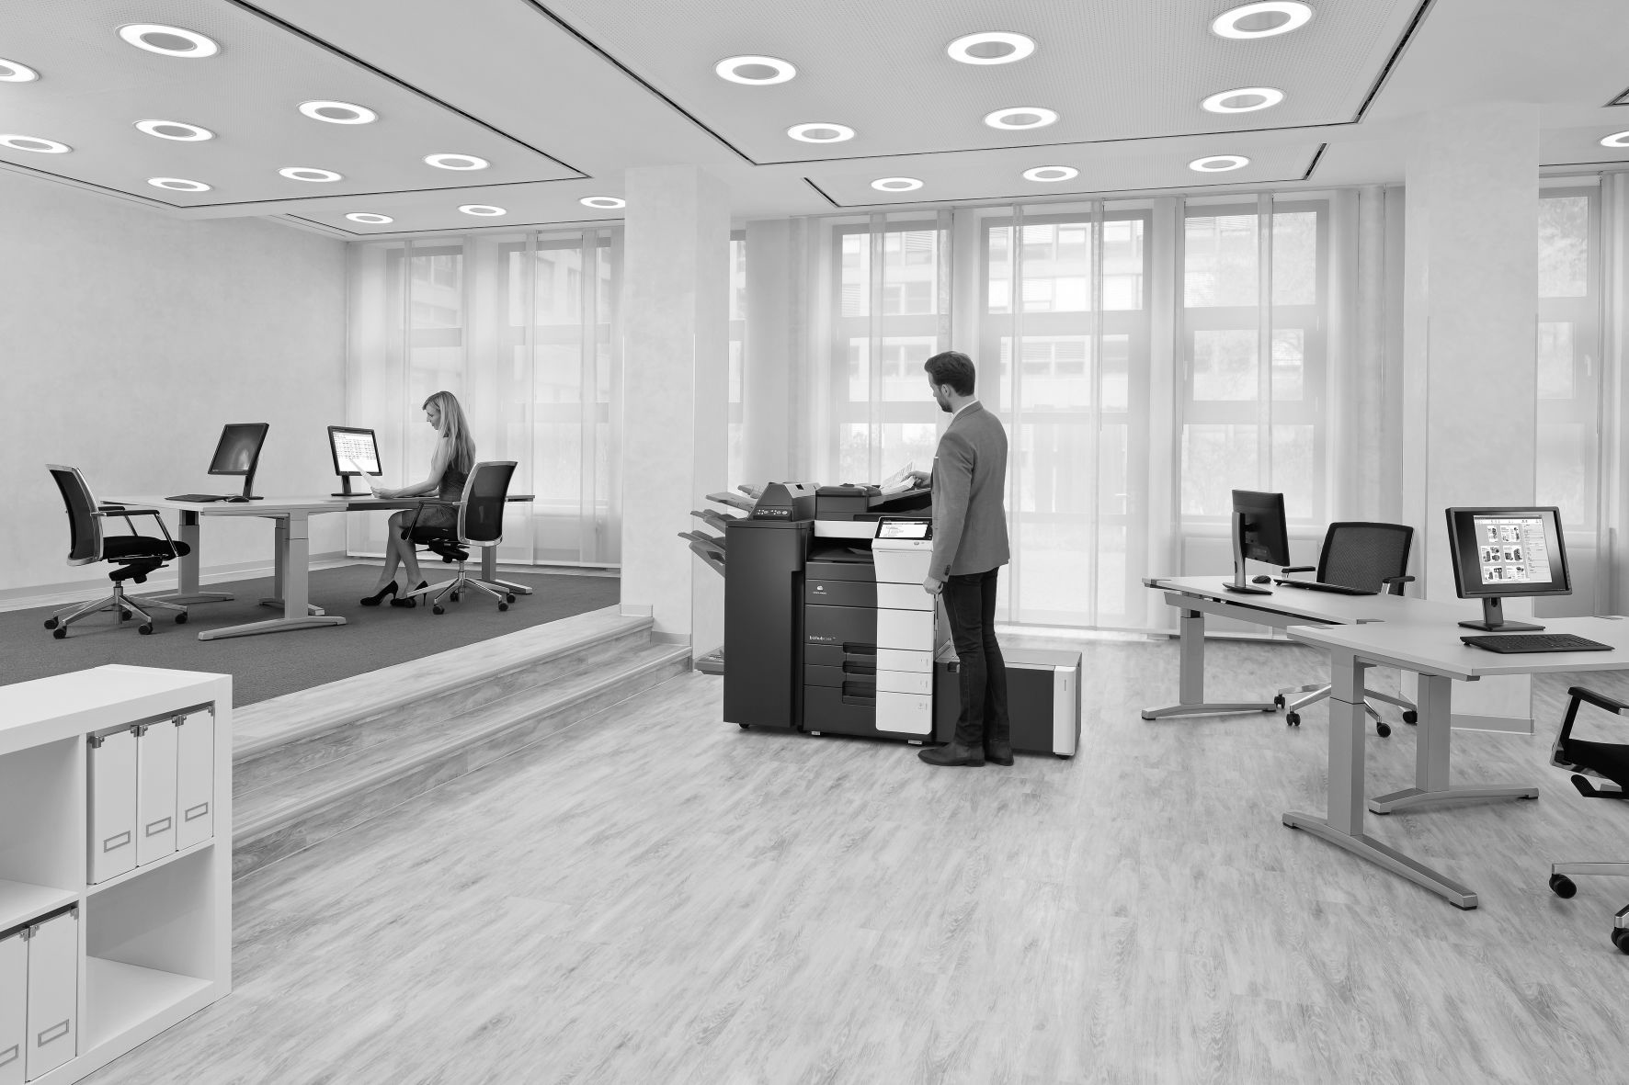
Dispatcher Phoenix Overview

Slide 4
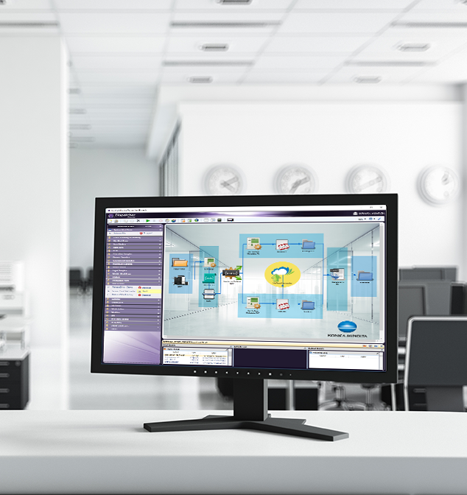

Dispatcher Phoenix is…
  Award Winning!
Konica Minolta-developed, award-winning automation solution designed to:
Optimize business processes
Reduce costs
Increase productivity
Drive collaboration
Promote growth and innovation
Received the 2021 ‘ASTORS’ Homeland Security Platinum Award for Best Imaging Technology
Selected as BLI’s 2022 Pick for Outstanding Workflow Automation Platform

Slide 5
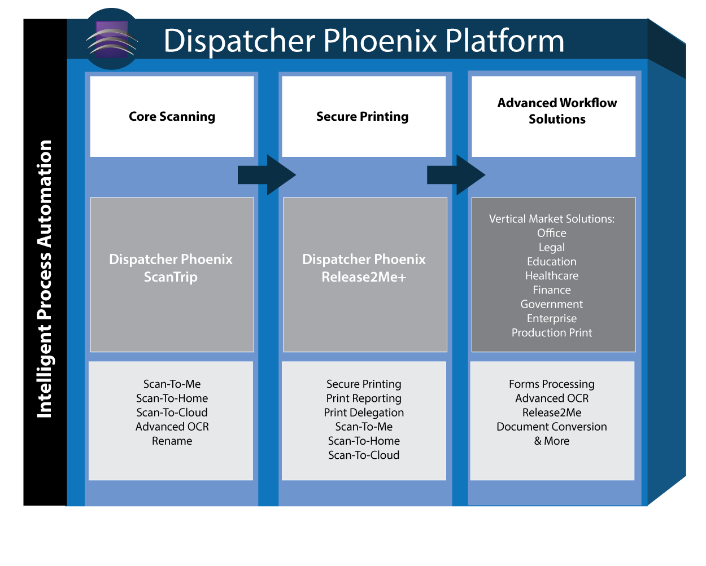
Streamlined Upgrade Process

Slide 6
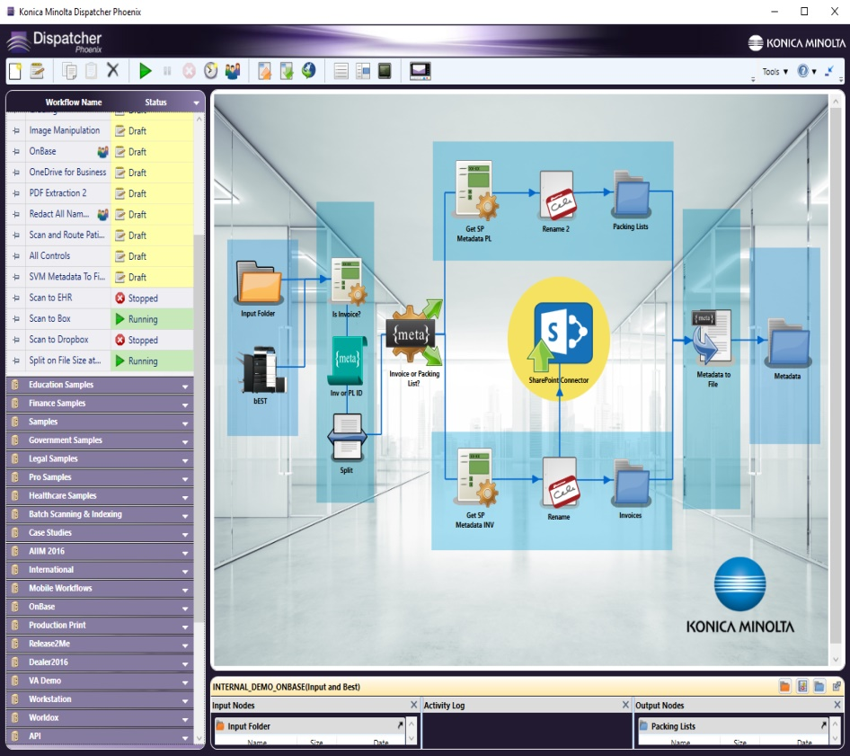

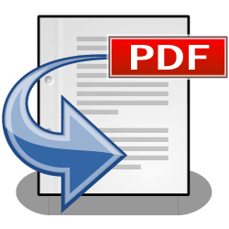

Providing Customized Workflows
Dispatcher Phoenix is designed to streamline our customers’ document processing tasks via automated workflows.
Capture Process Distribute
Files are automatically captured, processed, and distributed in a single step!
Dispatcher Phoenix makes creating workflows easy!

Slide 7
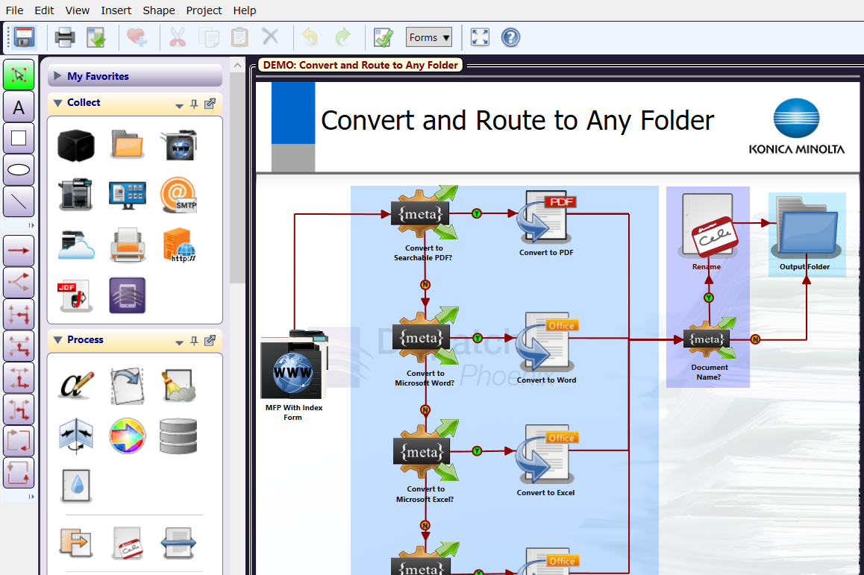
Intuitive Workflow Designer Tool
  Award Winning!
Dispatcher Phoenix comes with an easy-to-use, graphical Workflow Designer Tool that empower users to create customized workflows to suit their needs.
Users can take advantage of:
  Drawing tools.
  Text and formatting options.
  Drag-and-drop functionality via icons that represent inputs/processes/outputs.
  Connectors to draw the flow.
  Easy-to-follow validation messages.

Slide 8
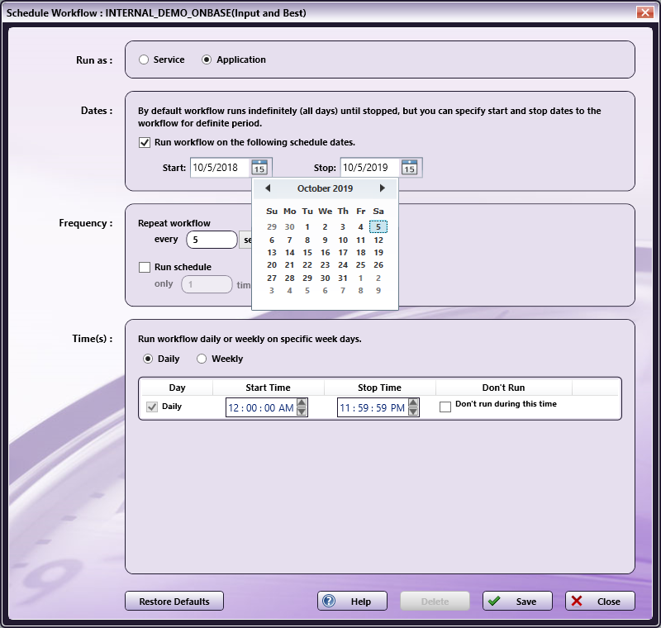
Schedule Workflows to run when you need them!
  Award Winning!
Specify a day of the week or time of the day along with a frequency to ensure workflows complete your automation needs when it’s most convenient for the team
Save valuable time and resources by scheduling high-volume, heavy processing workflows after business hours
Schedule workflows to run as a service continually while the PC is on

Slide 9
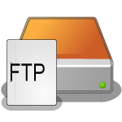



Optimize Workflows with LiveFlo
Displays files being processed through running workflows
Makes it easy to identify bottlenecks
Ensure that inputs, processes and outputs are optimized

Slide 10

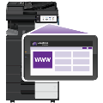


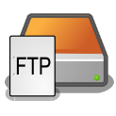






Advanced Capture Capabilities
  Documents are automatically collected from a variety of sources for advanced processing, routing, printing, or storing, including:
  MFP
  Watched Folder
  Email Inbox
  Mobile Device
  Workstation
  Web Capture
  FTP Server
  Dropbox Folder
  LPR Print Queue
  Etc.

Slide 11

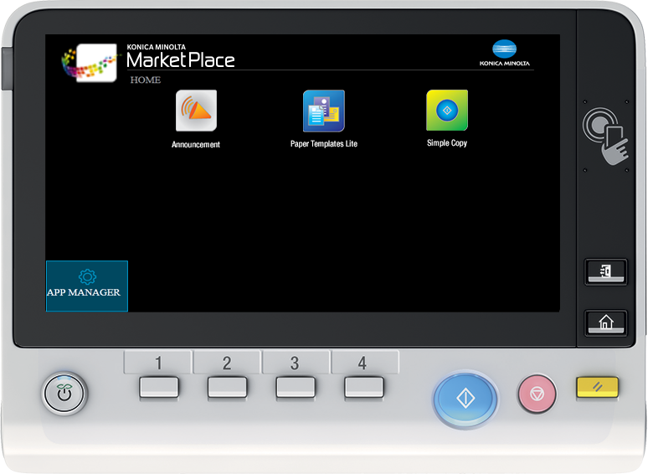
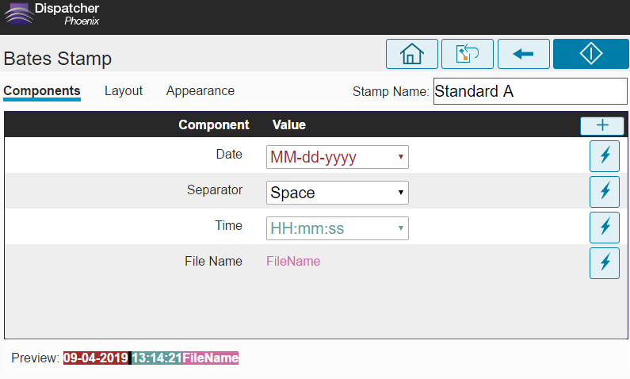
Automated Document Processes
Dispatcher Phoenix supports a variety of document processing tasks from the most simple to more complex including:
Advanced OCR
Annotation
Watermarking
Rename Files
PDF & Microsoft Office
Conversion
Redaction
Highlight & Strikeout
Bates Stamping
Barcode Writing
Zonal Extraction
Forms Processing
And more!

Slide 12






Intelligent File Routing Capabilities
  Add advanced intelligent file routing power to automated workflows!
  Barcode Processing
  Metadata Routing
Advanced OCR
  Page Count Route
Color Route

Slide 13

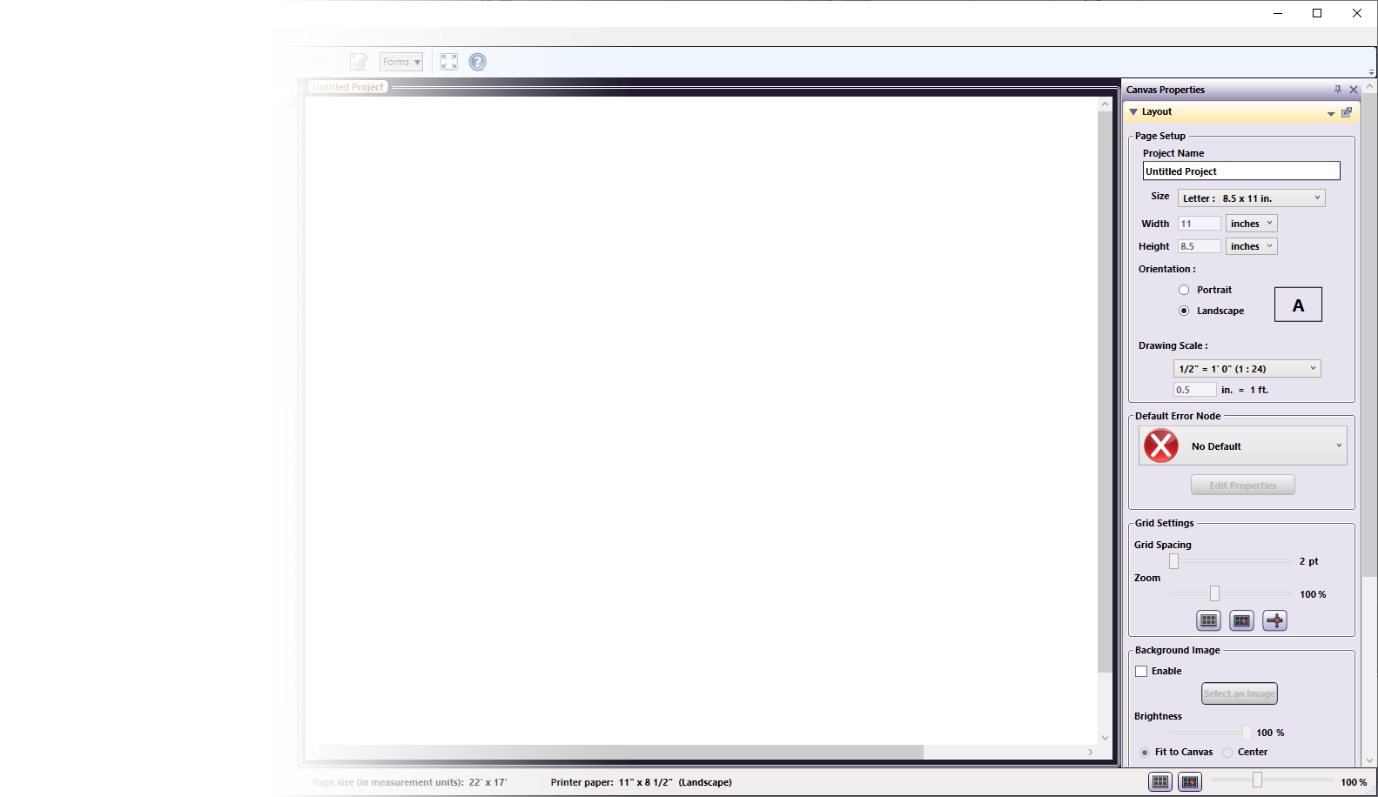







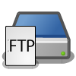


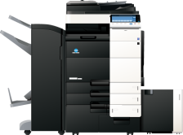





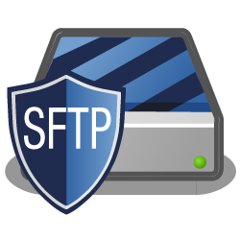

Store Documents In A Single Step
Workflows can be customized to send processed documents to a variety of outputs in a single step! Distribution options include:
Folder on the network or Desktop
FTP Server
SFTP Server
Email
Printer
RightFax
M-Files
Windows Fax
Production Print Systems
Guardian by LawLogix
OnBase by Hyland
Workshare
Laserfiche
And More…

Slide 14

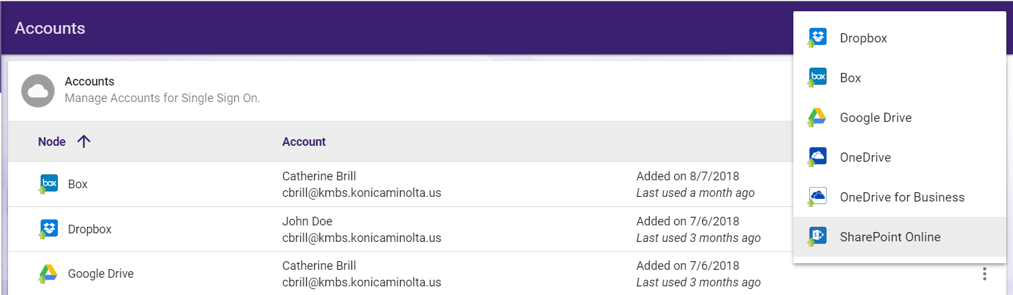
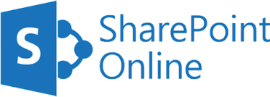







Connectors to the Cloud
Dispatcher Phoenix includes a variety of connectors to the leading cloud storage systems in the world today.
Includes single sign-on at the MFP to the cloud.
Web-based cloud account management tool allows for easy set up.

Slide 15

Promoting Scalability
Tailored solutions for our customers are made possible through the modular architecture of Dispatcher Phoenix
Optional add-in modules can be purchased at any time. For example:
  Bubble Grader for educators
  Rx Shield for physicians
  Release2Me for secure printing
  Specialized connectors
  Standard & 2D Barcode Processing
  Barcode Writer
  And more!

Slide 16
Dispatcher Phoenix Key Features

Slide 17
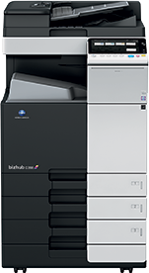
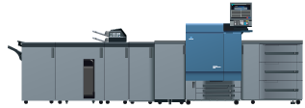
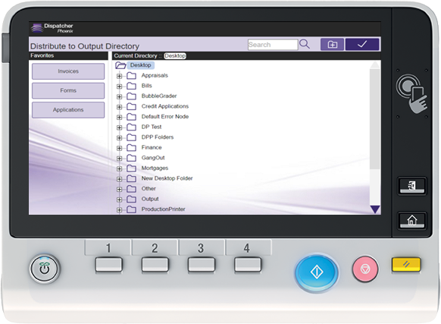
Intuitive MFP Integration
Tight integration with MFPs provides a graphical, unique, visually appealing experience for our customers
  Office MFPs
  Production Print systems
Easily index documents before they are processed and stored
Collapse, expand folders using a Windows Explorer-like view of your directory structure to easily find the folder to scan to
Create a new folder to scan to “on the fly”
Filter list of folders that appear with type-ahead search functionality
Display “Favorite” folders
Modify your document processes during scan time at the MFP panel!

Slide 18
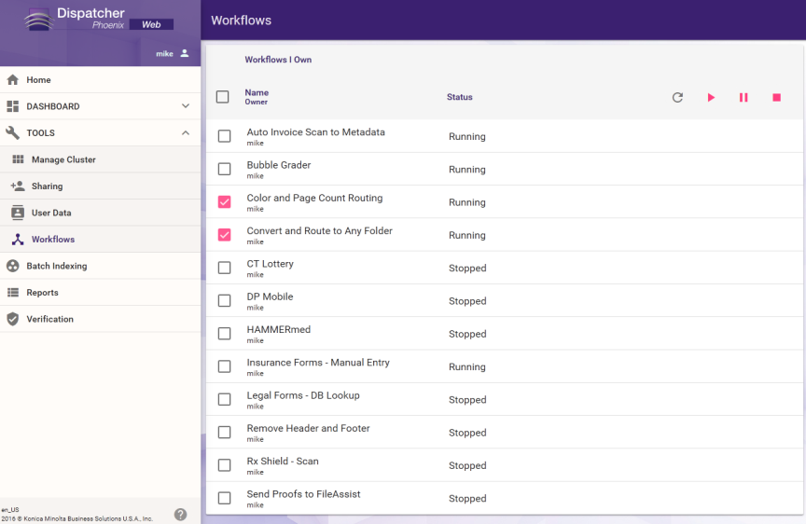
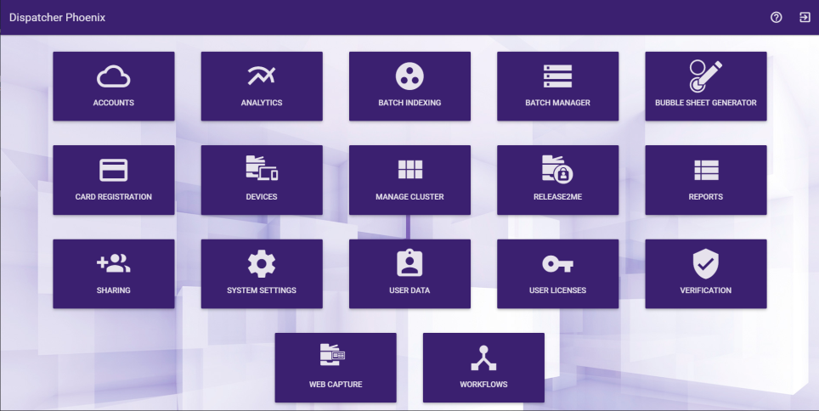
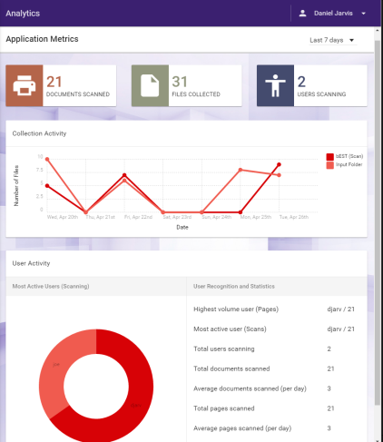
Web-Based Control
Dispatcher Phoenix’s Web User Interface provides centralized location for a variety of administrative tools, including:
  Cluster Management
  Analytics & Reporting
  Workflow Control
  Workflow Sharing
  User Data & Licenses
  Device Management
  ID Card Registration Tool
  Batch Indexing and Management
  Verification
  Print Delegation
  And more!

Slide 19

Intelligent Document Classification
Dispatcher Phoenix’s Doc-Classifier process intelligently categorizes and classifies incoming documents and files…with no human intervention required.
Doc-Classifier organizes and identifies operational documents, business forms, and other types of files from different industries, such as Finance, Legal, Insurance, and Education.
Doc-Classifier is the ideal solution for SMB to large-sized companies with a very high volume of documents.
Invoices
Bank Statements
Loan Applications
Purchase Orders
Birth Certificates
Wills
W-2 Forms
Non-Disclosure Agreements
Report Cards
Insurance Claims
And Much More!

Slide 20
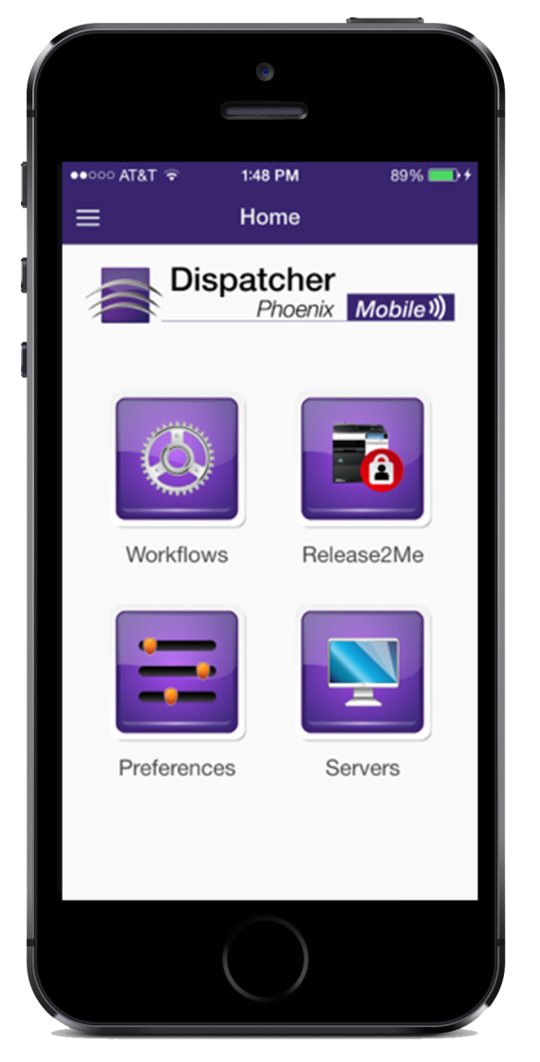
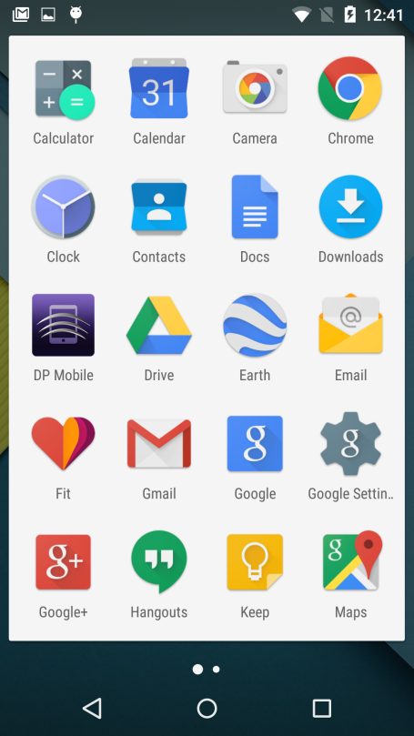
Mobile Accessibility
Dispatcher Phoenix Mobile app extends the power of workflow automation for an increasingly mobile workforce. With this app, users can:
Capture and submit documents directly from mobile device into Dispatcher Phoenix workflows for further processing/routing
Index documents from smartphone or tablet
Include geo-location information with files
Release print jobs from mobile device for secure and convenient printing

Slide 21
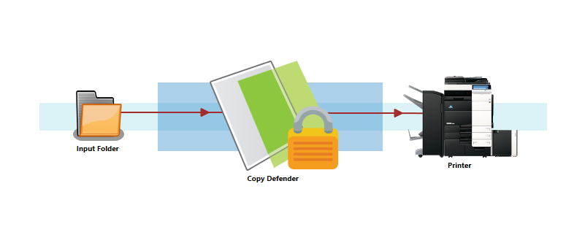
Stop Illegal Copying of Sensitive Documents
Secure government printouts with Dispatcher Phoenix’s Copy Defender.
With this automated feature, government agencies can ensure that:
  Security watermarks are automatically applied to printed documents.
  Copying of documents can be instantly canceled once the Copy Defender security settings are detected.
  A password is required to be entered before the copy operation can continue.

Slide 22

4 Types of Copy Protection
Copy Protect - Prints a copy security background pattern in the document. Text such as “Invalid Copy” or “Unauthorized” appears when the document is improperly copied.
Stamp Repeat - Adds stamps such as “Copy” and “Private” on the entire page.
Copy Guard – Embeds a copy restriction pattern on all printed sheets. If an attempt is made to copy a Copy Guard sheet, the copying process is canceled and the job is deleted.
Password Copy - Embeds a password on all printed sheets. If an attempt is made to copy a Password Copy sheet, the entry of a password is requested.

Slide 23
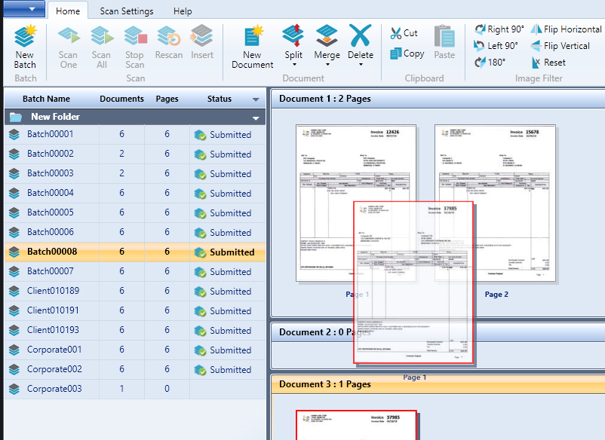
Workstation for Batch Scanning
Dispatcher Phoenix offers a powerful centralized scanning solution that scan operators can use to manage high volumes of paper documents.
TWAIN Support
Workstation is flexible, working with any manufacturer’s TWAIN-based scanners and TWAIN-compatible MFPs.
Document
Manipulation
Document Separation
Documents in the batch can be separated automatically, or by page count, blank pages, bar codes and patch codes.
With thumbnail images, DP Workstation allows operators to easily manipulate pages and documents. Flip, rotate or reorder pages, rescan images; insert new images; merge/split documents and more.

Slide 24
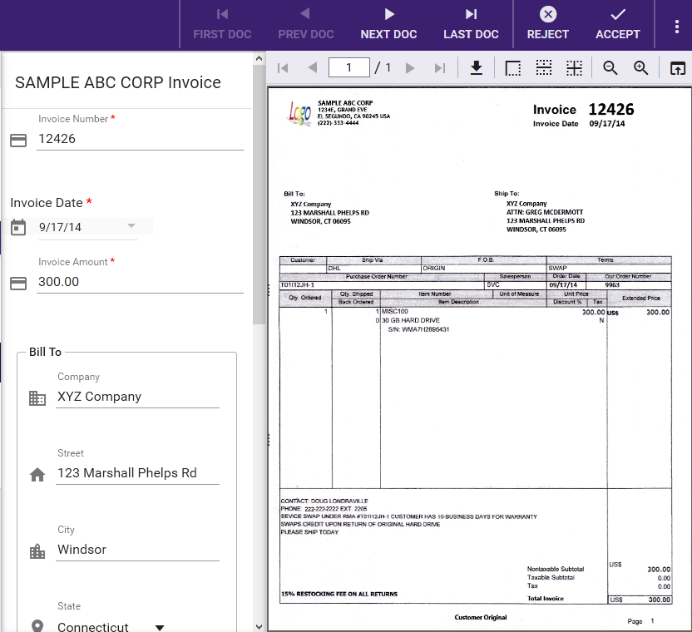
Streamline Indexing with Web-Based Tools
  With Dispatcher Phoenix Batch Indexing package, operators can quickly and easily index paper documents from a centralized location.
  Supports manual indexing using shortcut keys.
  Index fields can be pre-populated with data via Forms Processing or database lookups.

Slide 25

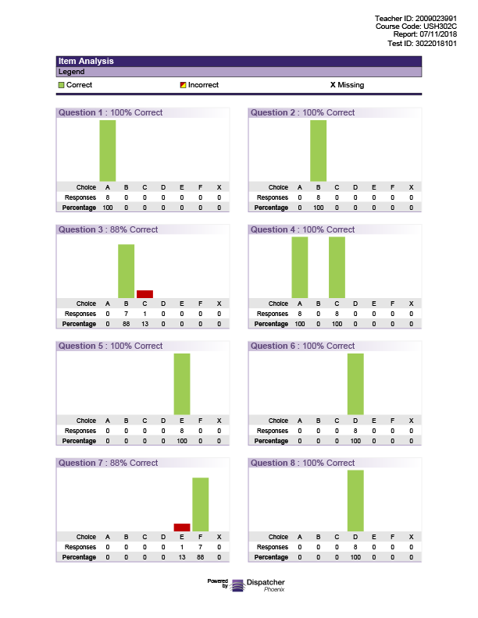

Bubble Sheet Grading
Teachers spend too much time and effort grading tests manually.
  Manual grading increases the chance of grading errors.
  Schools, colleges, and universities spend too much money on preprinted forms or slow scanning systems that are expensive to maintain.
Dispatcher Phoenix’s Bubble Grader solution automatically grades tests and generates
analytical reports about classroom
performance.
  Includes web-based bubble sheet
  designer which allows schools to
  create/print custom bubble sheets on plain paper! Huge cost-saver!

Slide 26

Secure Print Release System
Release2Me
Control exactly when and where you would like your documents printed
=
WASTED PAPER $$ DOWN THE DRAIN
=
Unattended printouts Major Security Risk

Slide 27
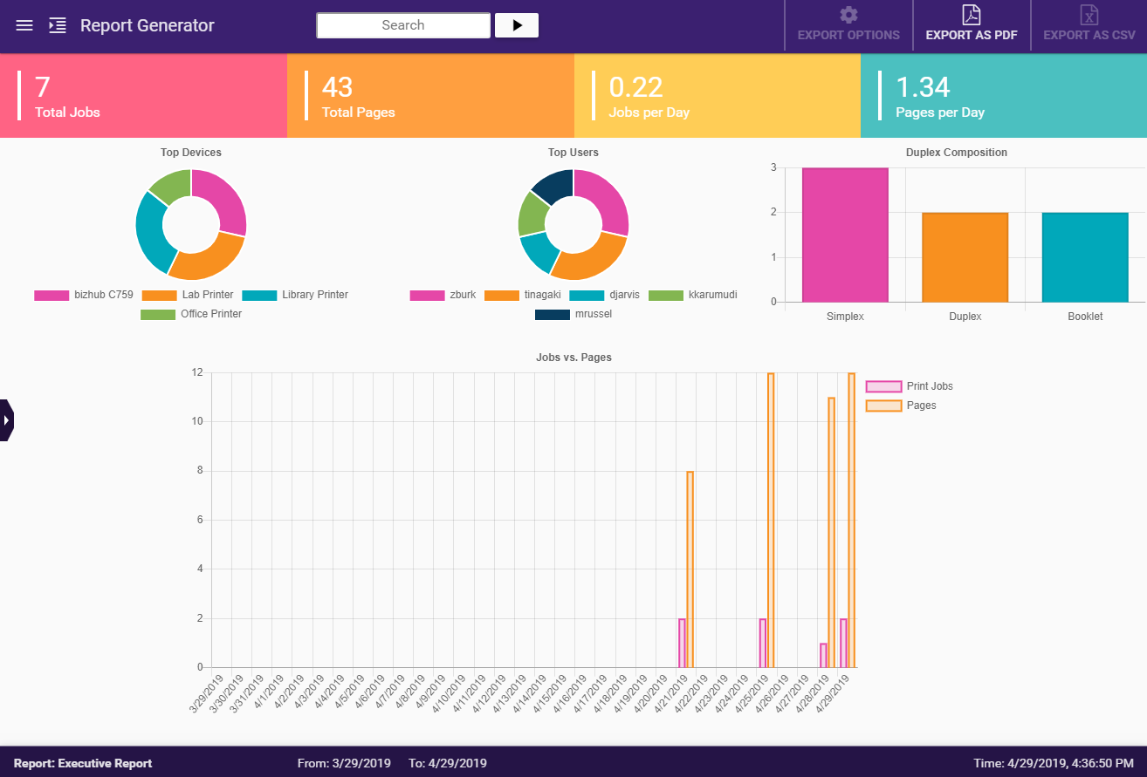
Release2Me Key Features
Users can access their secure print queue to release print jobs only after authenticating at MFP.
Optional print settings can be specified, including number of prints, duplex/simplex, etc.
Web-based print reports allow companies to monitor printing activity throughout the department.
Convenient print delegation allows employees to release jobs for another user, without requiring IT’s assistance.

Slide 28
Product Licenses

Slide 29
Streamlined Upgrade Process

Slide 30
Dispatcher Phoenix ScanTrip
ScanTrip is a stackable, standalone license that provides the powerful functionality organizations need for core scanning workflows.
With ScanTrip, the following workflows are available:
Scan to Home
Scan to Me
Scan to the Cloud
Dispatcher Phoenix ScanTrip includes a variety of connectors to popular document management systems and cloud storage applications including:
Box
Dropbox
FilesAnywhere
FileAssist
Google Drive
OneDrive
OneDrive for Business
SharePoint
SharePoint Online
WebDAV
ScanTrip Configuration | Processing Nodes | Input & Output Capabilities
Client Application | Rename | MFP Panel
Workflow Builder Tool | Advanced OCR | Web Capture
LiveFlo Technology | Metadata to File | Cloud Connectors
Dispatcher Phoenix Web |  | Output Folder
Workflow Scheduler |  | SMTP Out
Sample Workflows |  | MS Exchange Connector
Integrated MFP Simulator

Slide 31
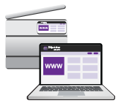
Key Benefits of ScanTrip
ScanTrip can be paired with other print management solutions that do not offer scanning capabilities
Ideal solution for customers who:
  Are looking to optimize their document digitization journey
  Need to streamline file storage to the cloud
  Require simple, low cost scanning solution

Slide 32
Dispatcher Phoenix Release2Me+
Release2Me+ provides a cost-effective, powerful, easy-to-use solution for secure print release and scan-to-cloud workflows.
Release2Me+ Configuration | Document Processing Functions | Input & Output Capabilities
Release2Me Secure Print Release | Rename | LPR In
Release2Me Print Reporting | Advanced OCR | MFP Panel
Release2Me Print Delegation | Metadata to File | Web Capture
Release2Me System Workflow | Release2Me | Cloud Connectors
Client Application |  | Output Folder
Workflow Builder Tool |  | SMTP Out
LiveFlo Technology |  | MS Exchange Connector
Dispatcher Phoenix Web
Workflow Scheduler
Sample Workflows
Integrated MFP Simulator
Dispatcher Phoenix Release2Me+ includes a variety of connectors to popular document management systems and cloud storage applications including:
Box
Dropbox
FilesAnywhere
FileAssist
Google Drive
OneDrive
OneDrive for Business
SharePoint
SharePoint Online
WebDAV

Slide 33
Key Benefits of Release2Me+
Key Benefits
Improves Document Security
  Users can choose to print documents from their Release2Me print queue when they are physically present at the MFP.
Optimizes Control
  Choose when and where you want to print out your confidential documents & monitor print activity via dynamic, web-based print reports.
Reduces Waste
  Only print what you need and save on printing costs
Increases Productivity
  Improved business operations optimizes time and resources
Streamlines Document Handling
  Scan to email, folders, or the cloud…directly from the MFP

Slide 34

The Dispatcher Phoenix 7.0 License
  Collection Nodes
  DP Mobile
  Dropbox In
  FTP In
  Google Cloud Print
  Input Folder
  LPR In
  MFP Panel
  MFP User Box
  Web Capture
  Processing Nodes
  Advanced OCR
  Annotate
  Color Route
  Convert to PDF
  Convert to PS
  Deskew
  Despeckle
  Insert
  Merge
  Metadata to File
  Metadata Routing
  Metadata Scripting
  Mirror Image
  Negative Image
  ODBC
  Page Count Route
  Parse & Distribute
  Parse & Insert
  Parse & Replace
  Parser
  PDF Metadata Extraction
  PJL Print Preferences
  Print to File
  Rename
  Split
  Watermark
  Distribution Nodes
  Box Connector
  Dropbox Connector
  FilesAnywhere Connector
  FileAssist Connector
  FTP Out
  Google Drive Connector
  Microsoft Exchange Connector
  OneDrive Connector
  OneDrive for Business Connector
  Output Folder
  Printer
  SFTP Out
  SharePoint Connector
  SharePoint Online Connector
  SMTP Out
  WebDAV Connector
A full featured and comprehensive workflow automation license with OCR!

Slide 35
Target Markets

Slide 36








Target Market:
Who Is Our Customer?
ECM
Legal
Office
Full-featured workflow automation solution to address enterprise level document processing challenges
Automating manual administrative tasks in order to take on more clients
Streamlining file storage, organization and other document processing workflows
Education
Allows educators to focus on teaching by eliminating the grading process
Healthcare
  Prioritize patient service with scan-to-EHR Connectivity
Finance
Streamline document handling by routing files based on metadata
Government
  Instant access to the information government officials need, while complying with security regulations

Slide 37
Ascertaining Business Needs

Slide 38

Ascertaining Business Needs:
What Are Your Pain Points?
Do you currently use a manual process to handle your documents?
Do you currently spend a lot of money outsourcing document processing tasks?
Do you have repetitive, manual tasks that use up a lot of resources and time to complete?
Does someone in your organization spend a lot of time sorting through paper documents and distributing them to various departments?
Does it take a long time to organize the emails and email attachments that come in on a daily basis to your office?
Do your employees work remotely and need centralized access to their documents?
Are you losing documents or taking too long to retrieve the documents you need, when you need them?
Are you still storing a lot of your critical business information via paper documents?

Slide 39
Ascertaining Business Needs:
Qualifying Questions for Vertical Markets
Legal Market
Do you need to hire temporary staff to manually redact or annotate client files?
Do you have a hard time finding the case records you need for trials?
Do you need to comply with e-filing requirements?
Are you looking to integrate with a 3rd party case management system?
Education Market
Do you need to streamline the process of grading student bubble sheets?
Does your school system need to evaluate classroom performance?
Do you need to save money on preprinted bubble sheet tests?
Do you need to easily digitize and process your school’s applications and forms?
Government Market
Do you need to prevent illegal copying of confidential documents?
Do you need to organize and classify documents?
Do you need to respond to privacy regulations?
Do you use barcodes to streamline document handling?
Do you need a secure solution that complies with FIPS 140-2 Encryption?
Finance Market
Do you need to identify and extract information from files, such as customer contact details and amounts?
Do you want to quickly route files to existing applications, reducing the time and costs associated with manual labor?
Do you need to protect confidential client information?
Do you need to transform incoming documents and communication into actionable data?

Slide 40
Ascertaining Business Needs:
Qualifying Questions for Vertical Markets (Cont.)
Healthcare Market
Do you need to scan patient records to an Electronic Health Record application?
Do you need to index documents at the MFP panel before they are stored in a 3rd party system?
Do you need a system that complies with HL7 and CDA international standards?
Do you need to save money on preprinted, secure prescription forms?
Faith-Based Market
Do you need secure printing of donor records, bylaws, or meeting minutes?
Are you looking to digitize your backlog of paper records?
Do you need a direct connection at the MFP to a document management system?
Do you need scanned files to be instantly converted into editable or searchable format?
Production Print Market
Do you need to intelligently manipulate print files for streamlined printing?
Do you need to produce customized mailers or other kinds of communication?
Are you manually preparing your files for printing (e.g., ganging, imposition, preflight checks, etc.).
Do you need to route your files to a printer based on color/file size/number of pages?

Slide 41

Ascertaining Business Needs:
What Is Your Cost Of Doing Nothing?
Manual businesses processes take more time.
Outsourced tasks are too expensive.
Errors can be introduced into your workflow.
Critical business information can be hard to find, leading to bad customer service.
Sensitive personal information can be exposed, leading to confidentiality violations.
Productivity is hampered.
Employees are frustrated and consumed by tedious work.

Slide 42

Ascertaining Business Needs:
What Does Success Look Like?
Documents are processed and files are routed automatically, with no human intervention required.
Your employees’ time is freed up.
Document indexing is automated via zonal OCR and database lookups.
You can log into your cloud service / document management system directly at the MFP control panel.
Your operational efficiencies, communication, and collaboration are optimized.
You can easily comply with state and federal regulations.
Paper documents are quickly captured, digitized and converted to the correct format for searching and editing (e.g., Searchable PDF, Word, etc.).
Confidential information is permanently protected via automated redaction technology.
Print files are modified “on the fly.”
Large volume of documents are quickly sorted, indexed, and stored in the cloud.
Printouts are always secured, and printing costs are reduced.
Files are processed, sorted, and routed based on content.

Slide 43
Resources

Slide 44

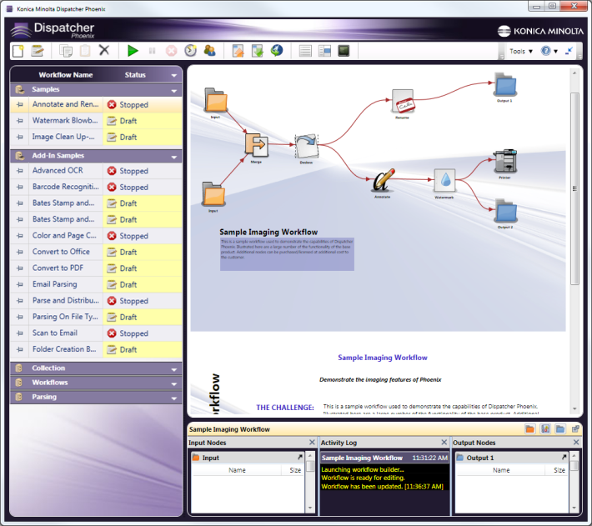
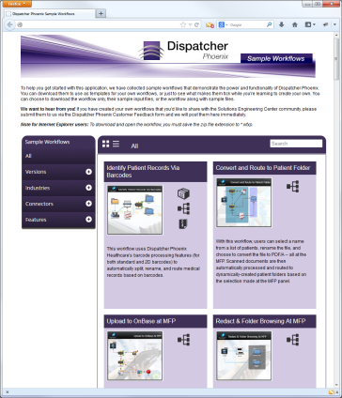
Get Started Quickly
Fully-configured sample workflow templates include:
Description of use case (challenge, solution, benefits)
Sample input files
Perfect for first-time users
Access to large online library of additional sample workflows to get you started with any task

Slide 45


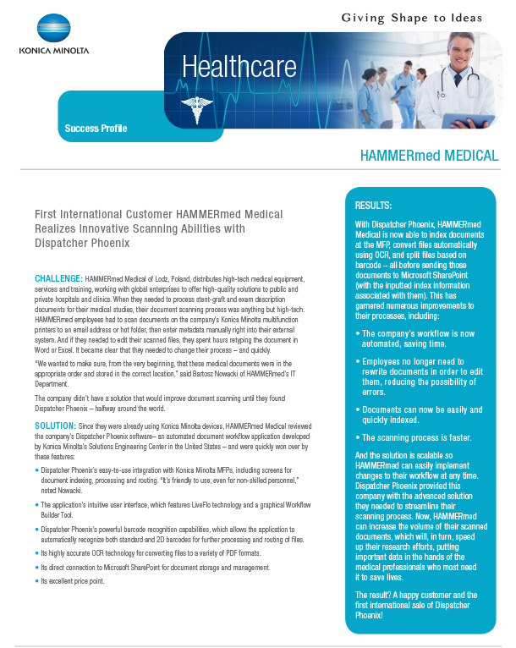
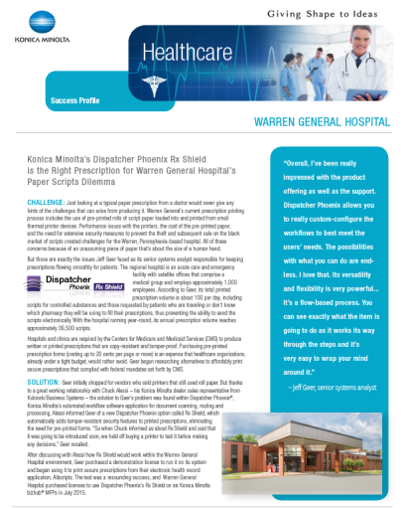
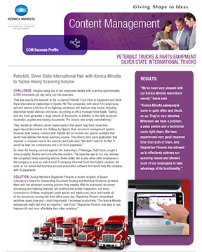
What’s Available for You & Your Customers
Demo Licenses
Fully-functional 30-day demo licenses of Dispatcher Phoenix
Download today from: sec.kmbs.us
Marketing Collateral
Dispatcher Phoenix Brochures for all
Vertical Markets & Individual Connectors
Dispatcher Phoenix Battle Cards
Download today from: MyKonicaMinolta.com
Other Resources
NFR Licenses for Demo Rooms: sec.kmbs.us/nfr
Online help: docs.dispatcher-phoenix.com/

Slide 46




Thank You
sec@kmbs.konicaminolta.us

