Slide 1



Spotlight On: Dispatcher Phoenix Professional for Automated Workflows

Slide 2


Automation is Here – Are Businesses Ready?
of workers use some type of automation in their day-to-day work.
work on a team or in a department that is actively taking steps to automate daily operations.

Slide 3

Key Advantages of Automating Workflows
Reducing the manual effort needed to complete mundane tasks.
Cutting down on manual errors.
Shrinking the processing time for individual steps.
Getting insights into process performance metrics.
Gaining greater process visibility and identifying potential bottlenecks.
Making sound business decisions based on data.

Slide 4
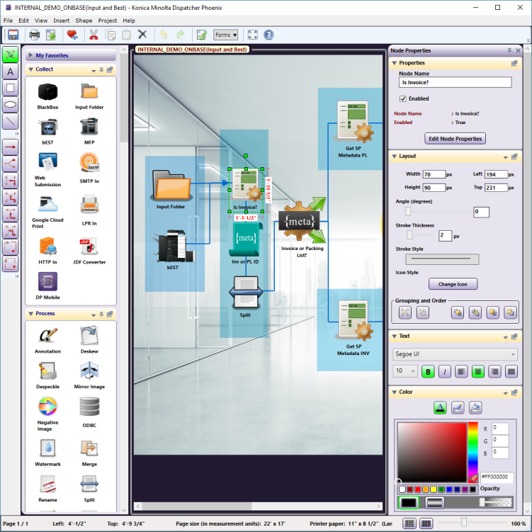
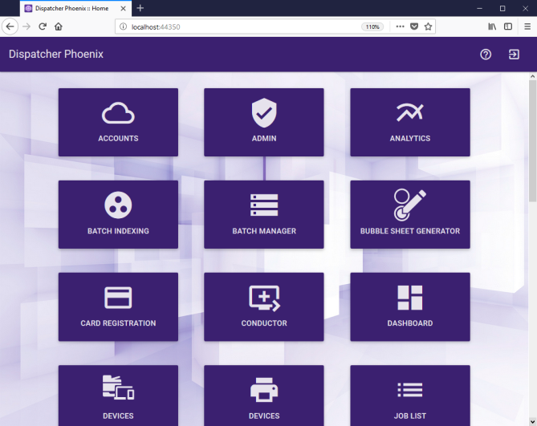
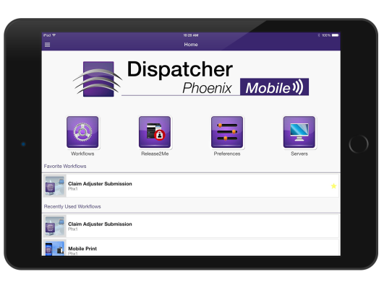
Your Document Processing & Workflow Solution Should Be:
Powerful enough to handle any business workflow.
Easy-to-use and intuitively designed.
Full-featured to address simple to complex document processing challenges.
Expandable as your business needs grow.

Slide 5


The Dispatcher Phoenix Family
An automation solution that optimizes business processes, reduces costs, and increases productivity for any organization by:
Automatically collecting files from various locations.
Simplifying scanning/indexing operations at the MFP.
Processing files automatically.
Connecting to cloud applications and popular document management systems:
Google Drive
One Drive
One Drive for Business
Microsoft SharePoint
SharePoint Online
Dropbox
Box.com
Worldox
FilesAnywhere
WebDAV
FileAssist
OnBase
Much More
Award Winning! BLI 2018-2019 Legal PaceSetter Award; BLI 2017-2018 Financial Services PaceSetter Award; Finalist for World Technology Network Award

Slide 6










Simple, Economical & Powerful
Dispatcher Phoenix Foundations Dispatcher Phoenix Healthcare Dispatcher Phoenix ECM
Dispatcher Phoenix Professional Dispatcher Phoenix Education Dispatcher Phoenix ECM Basic
Dispatcher Phoenix Legal Dispatcher Phoenix Finance AccurioPro Connect
Dispatcher Phoenix Government Dispatcher Phoenix Office

Slide 7

Key Features To Help Streamline Workflow
Built in features of any Dispatcher Phoenix edition to make it easy to build custom workflows that address any document workflow challenge:
Graphical Workflow Designer Tool
Workflow Scheduler
Full MFP Integration
Authentication Options including single sign-on
Index Form Builder Tool
LiveFlo Technology
Web User Interface
Mobile App
Highly Scalable

Slide 8
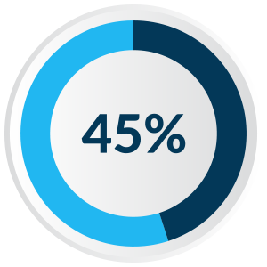
A Tailored Solution
With Dispatcher Phoenix’s enhanced scalability, you can create unique, modular, cost-effective solutions tailored to client needs. Optional add-in modules include:
Forms Processing
Cloud Connector Bundle
Advanced Bates Stamp
Advanced OCR
Barcode Processing
Bubble Grader
Convert to Microsoft Office
Convert to PDF
Copy Defender
Redact, Highlight & Strikeout
Release2Me
Rx Shield
feel automating workflows would be cost-prohibitive

Slide 9









Optimize Workflows with Dispatcher Phoenix Professional
1
Capture jobs automatically from a variety of sources.
2
Process and route jobs with automated ease.
3
Distribute jobs in a single step.

Slide 10



Route Jobs with Automated Ease
Intuitive scanning, document indexing, and folder browsing.
Enhanced document routing capabilities with Color Route and Page Count Routing.
Easily define rules for routing using document metadata.
Single sign-on to popular document management systems, including Microsoft SharePoint.

Slide 11
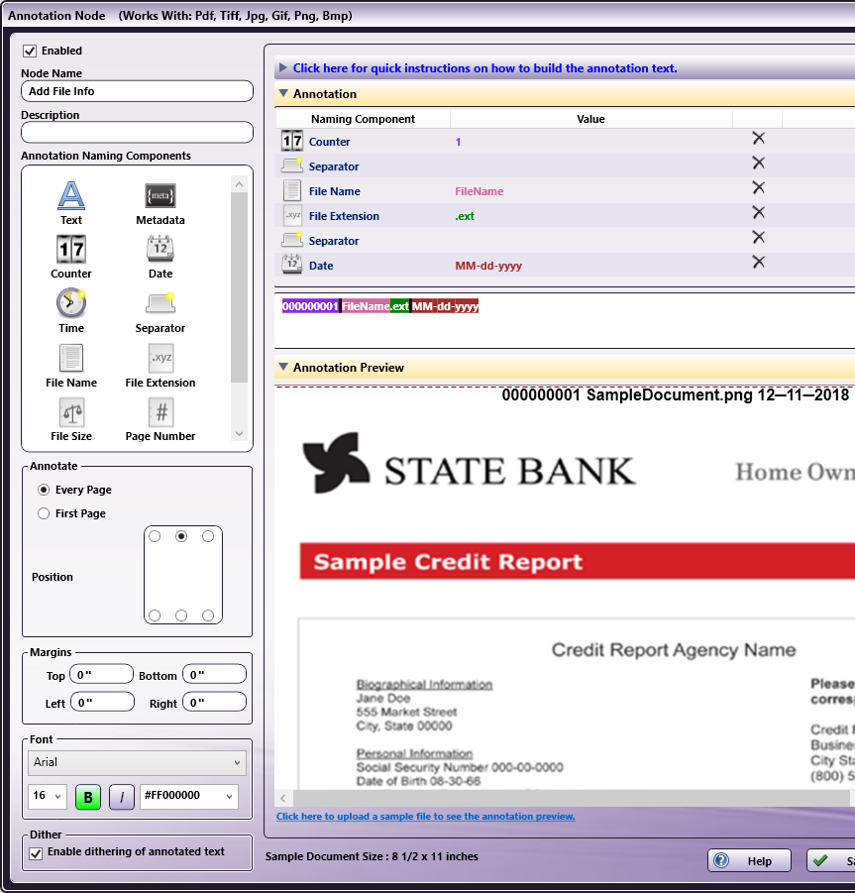
Customize Print Files Automatically
Simplify complex parsing tasks with the Parsing Bundle.
Support for annotations and watermarks.
Complete file conversion to Postscript or PRN.

Slide 12
Use Cases

Slide 13


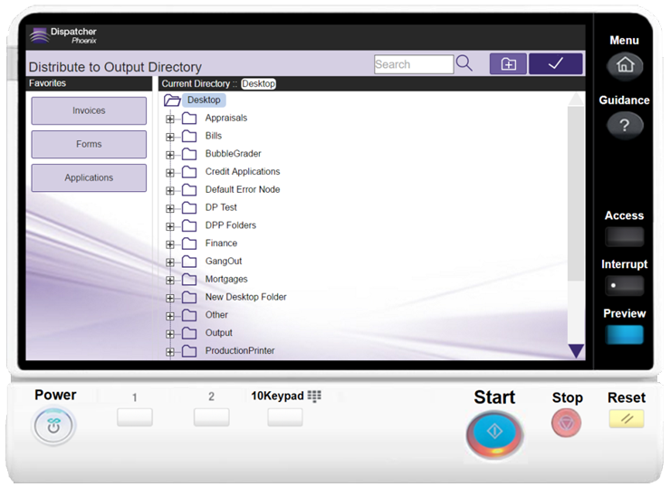
Improve Efficiencies with Indexing
An organization was looking for an intuitive process that would allow employees to scan documents and index them for long-term storage.
With Dispatcher Phoenix Professional’s file indexing features, they were able to:
Quickly & easily scan and index documents.
Browse their PC’s folder structure and select the correct folder to store documents at the MFP Panel.
Search existing folders and create new folders with ease.

Slide 14

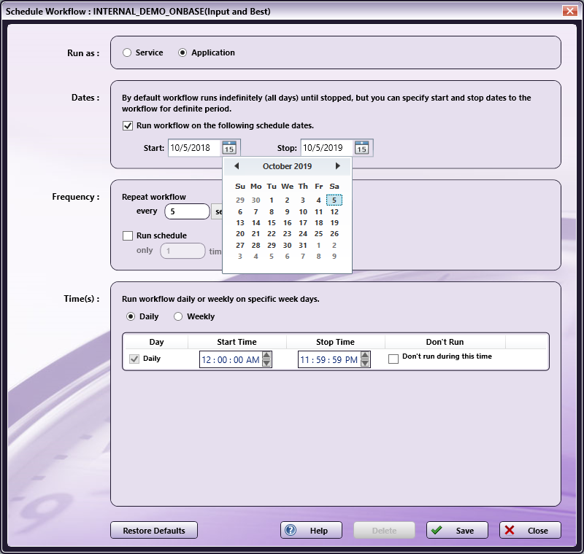
Schedule Workflows
An organization was looking for a workflow management solution that could handle a large volume of documents and would not interrupt their day-to-day operations.
With Dispatcher Phoenix Professional’s Workflow Scheduler, they were able to:
Maximize their business’ uptime.
Schedule workflows to run at a particular time (e.g., midnight).
Other options include:
Specifying the interval at which the workflow should run.
Choosing the exact date/time that the workflow should run.

Slide 15

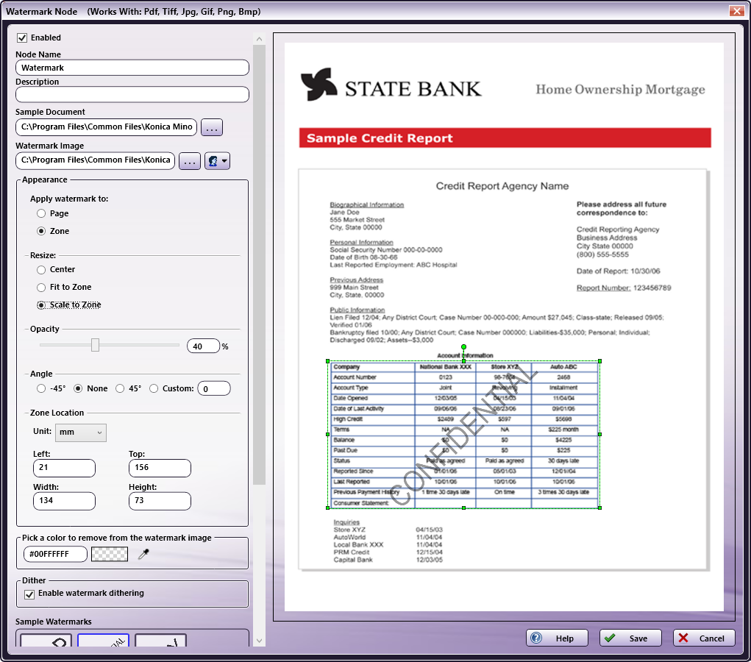
Improve Productivity with Enhanced Processing Activities
A business was looking for a way to quickly and easily add an identifier to scanned documents at the MFP and secure their printed documents.
With Dispatcher Phoenix Professional they were able to:
Create a custom date/time annotation that was applied to the documents after scanning.
Automatically apply a Confidential watermark and rename documents as part of the workflow.

Slide 16
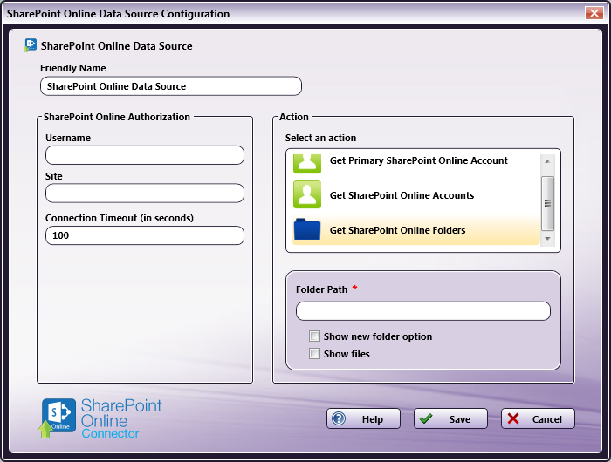
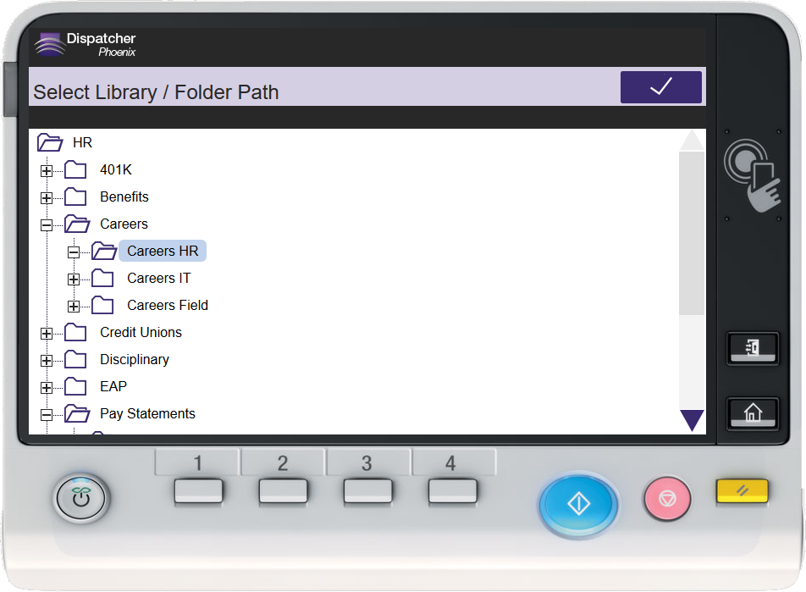
Drive Collaboration with Scan to SharePoint
A business was looking for a way to allow employees to seamlessly scan and index documents to Microsoft SharePoint.
With Dispatcher Phoenix Professional they were able to:
Capture scanned documents at the MFP and automatically route them to Microsoft SharePoint via a single sign-on.
Create index forms using easy-to-use Index Form Builder to allow for custom indexing screens to display at the MFP.

Slide 17

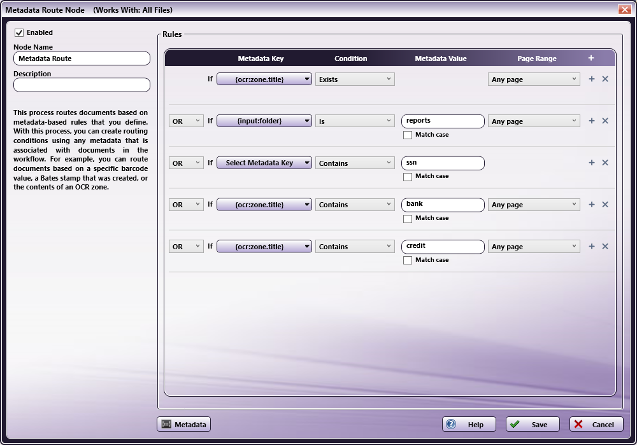
Organize & Retrieve Files with Metadata Processing
An organization needed an automated process to distribute files appropriately based on document metadata. Additionally, they needed to be able to integrate the metadata from scanned documents into a third party solution, such as a CRM system.
With Dispatcher Phoenix Professional they were able to:
Organize files based on their number of pages, file name, annotation, etc.
Extract metadata in separate, custom formatted files for import into other applications.

Slide 18

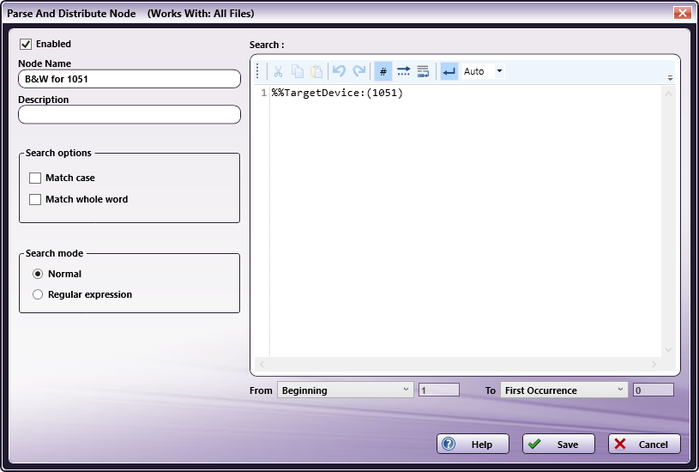
Boost Workflow with File Parsing Tools
A production printer was looking for a solution to parse and distribute files to be printed on the correct medium based on the content of the page.
With Dispatcher Phoenix Professional, they were able to:
Evaluate ASCII-based files (text, Postscript, PCL, etc.) based on specific conditions.
Insert paper tray commands once the condition is found.
Other File Parsing options include:
Using regular expressions
Replacing keywords
Routing files based on user-defined rules

Slide 19
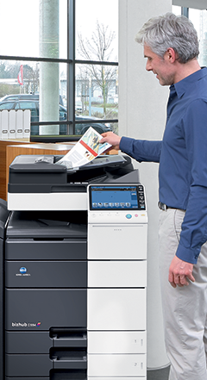

Manage Information with ODBC Processing
An organization needed a better process for organizing their scanned documents. They needed to be able to automatically route documents to folders based on the client name.
With Dispatcher Phoenix Professional, they were able to:
Retrieve client names from ODBC database for display on MFP panel.
Choose appropriate client name at panel.
Dynamically create folders based on selected name.
Associate data from the database to incoming files.

Slide 20
Workflows

Slide 21
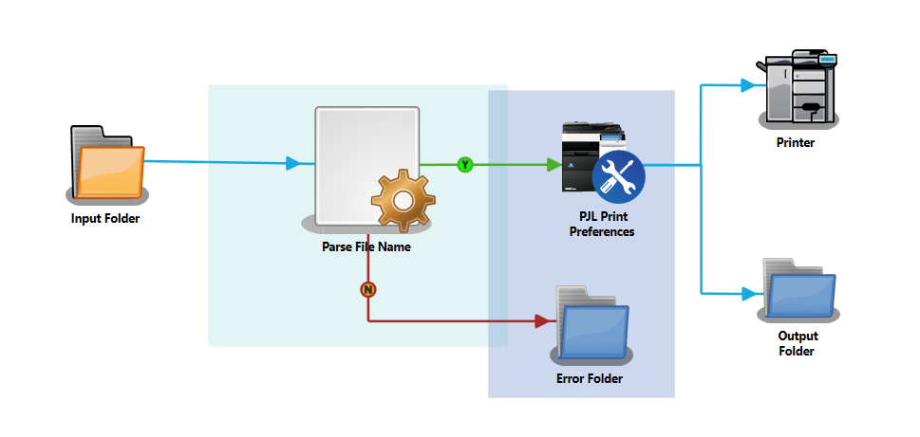
Parse & Edit Workflow
For organizations with legacy mainframe systems that are difficult and expensive to customize, the Parsing tool looks for specific data points in a file name using a regular expression. The found values are then associated with print commands including number of copies, duplex/simplex, etc.

Slide 22
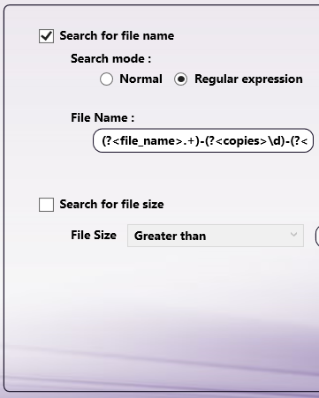


Dispatcher Phoenix Parsing Tools
Insert Process: Inserts a text string at the beginning or end of a file or a specific line number within the file.
Parser Process: Searches file attributes, such as file name, file type, and size.
Parse and Distribute Process: Searches for a keyword or text string within a file.
Parse and Insert Process: Inserts a text string into a file after the object of a search has been found.
Parse and Replace Process: Replaces text found by a search rule.

Slide 23
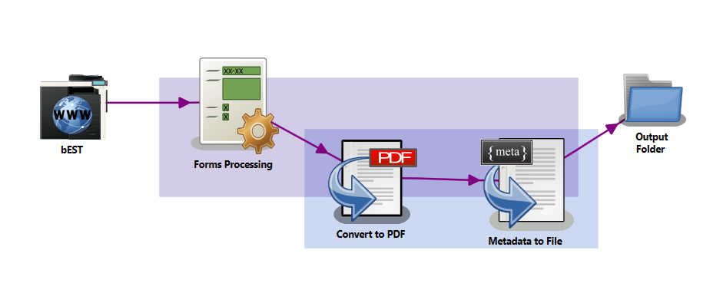
Forms Processing Workflow
A challenge many organizations face is finding a single line within a block of text. With Dispatcher Phoenix, you can quickly and easily identify the section of the document that needs to be searched. Then, a regular expression is used to identify the required value (client ID, customer number, invoice number, etc.). The workflow then converts the file to a Searchable PDF, exports the metadata from forms processing and uses the customer name to dynamically store documents by client name.

Slide 24
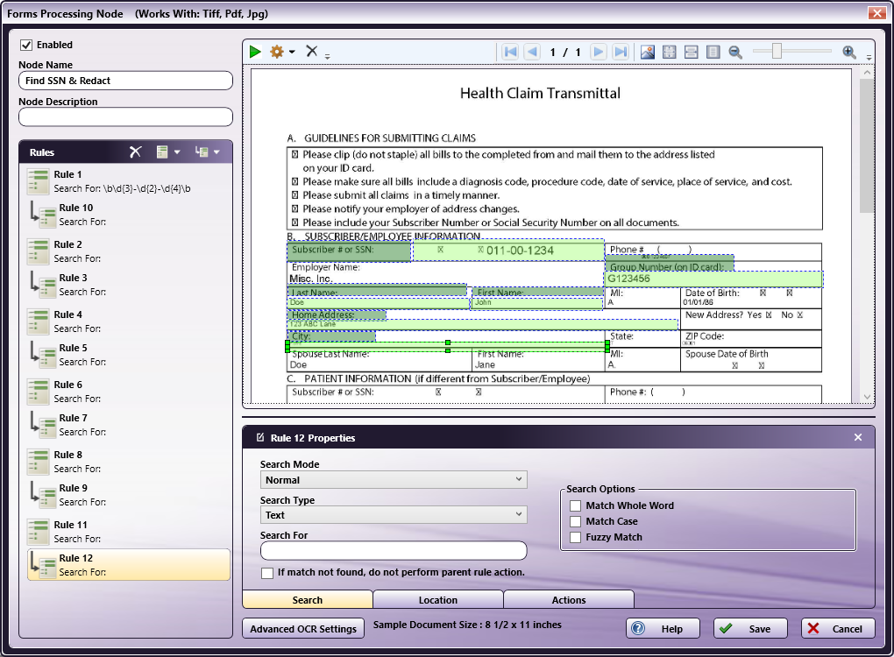

Forms Processing with Dispatcher Phoenix
Search forms for text and barcodes using regular expressions and standard patterns, such as phone numbers, social security numbers, etc.
Advanced Pattern Matching Tool includes a library of commonly used patterns and the ability to create custom patterns specific to a clients unique data.
Preview capabilities and validation messages allow you to test the configuration before running the workflow.
Add-On feature for Dispatcher Phoenix Professional.

Slide 25
Demo

Slide 26
Resources

Slide 27

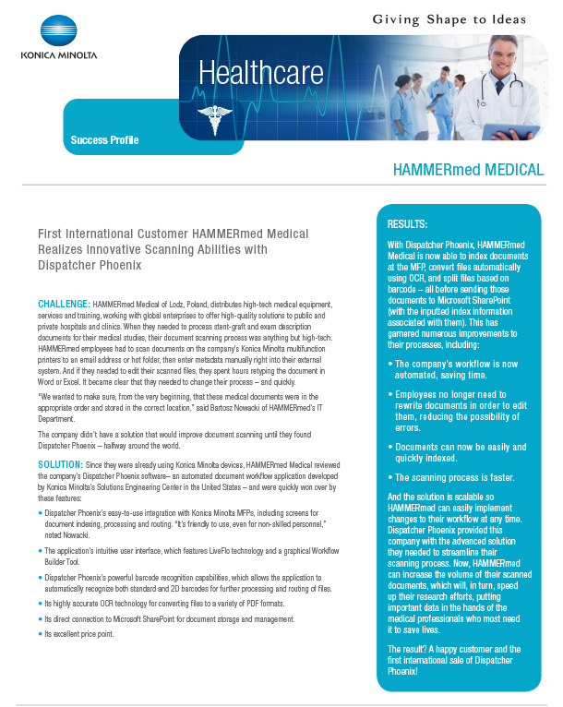
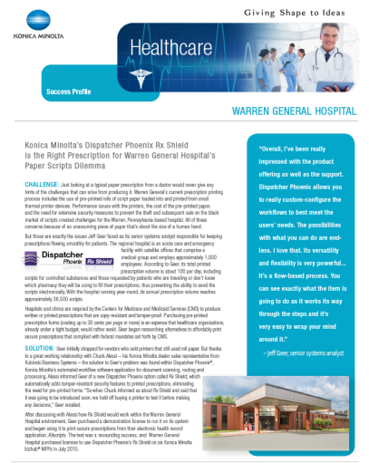
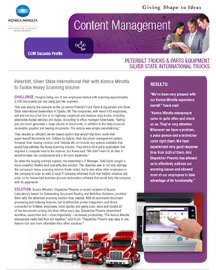
Customer Success Profiles
Transportation: Peterbilt
OnBase Connector
Legal: Casner & Edwards
Dispatcher Phoenix Legal
Healthcare: Warren Gen. Hospital
Rx Shield
Global: HAMMERmed, Poland
Barcode Processing/File Conversion

Slide 28


White Papers
Security
Dispatcher Phoenix ensures document confidentiality, allows for system authentication and provides clear audit trails in every document-intensive industry.
This White Paper describes how the application can be used to help organizations comply with security requirements.
Enterprise
Discover how Dispatcher Phoenix’s scalable platform will enable your organization to optimize performance for your environment.
Find guidance and best practices for mission critical deployments including automated enterprise features such as failover, load balancing, replication and workflow offloading.

Slide 29



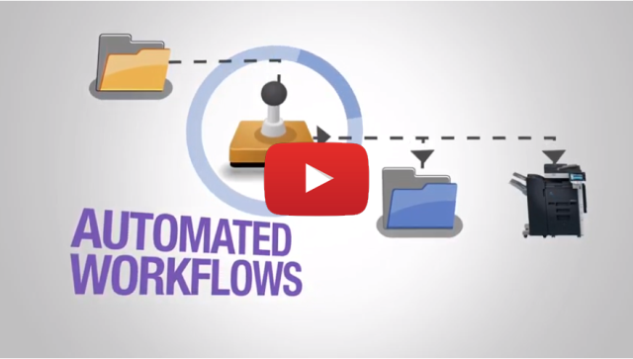
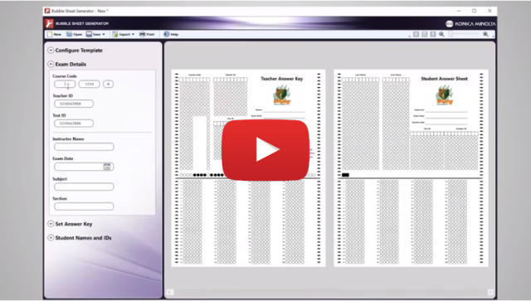
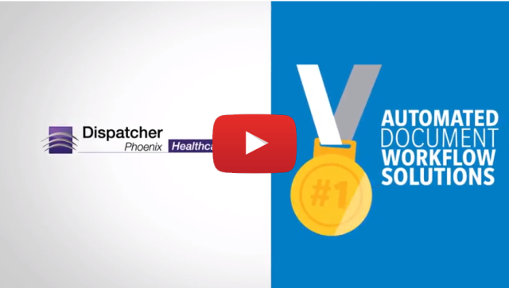

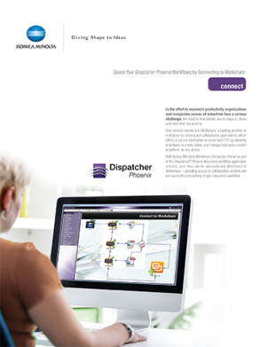


Marketing Collateral
Sales Resources for all Editions
Dispatcher Phoenix Professional Brochure
Sell Sheets for Connectors Battlecards
YouTube Videos
General Overview
Healthcare
Bubble Grader

Slide 30
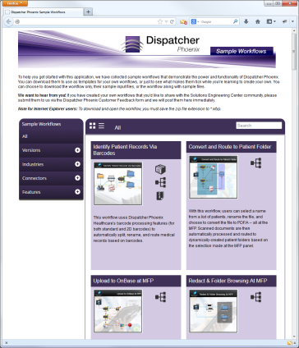
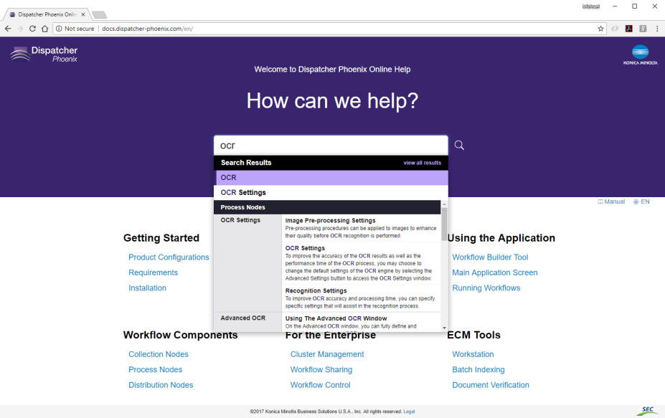
Other Resources
Sample Workflows
Fully-configured sample workflows include:
Convert and Route to Any Folder
Image Clean Up
ODBC Processing
Parse & Distribute
Scan to Folder and/or Email Address
Forms Processing
Online Help
Comprehensive online documentation & solution walk-through
Intuitive, autocomplete search capabilities

Slide 31
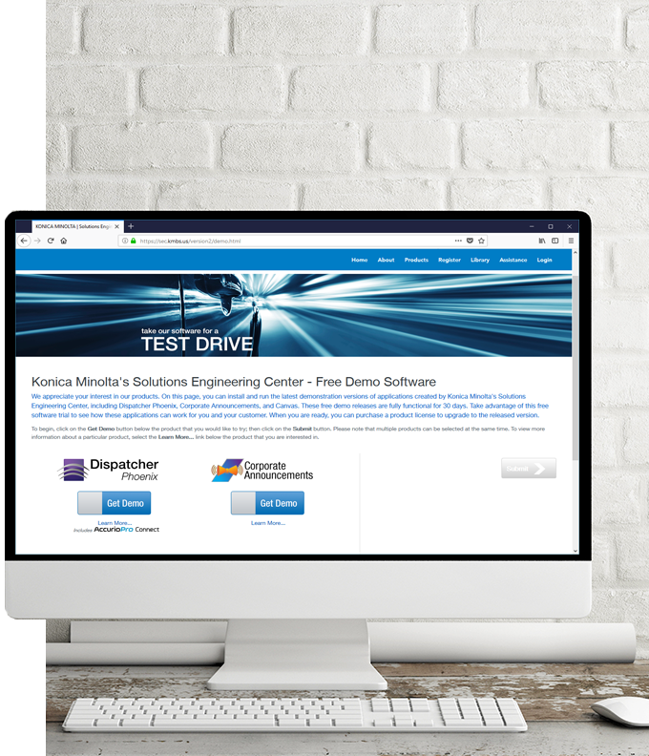
Available For You
LICENSES NFR (Not For Resale) licenses for Konica Minolta personnel involved in selling or supporting Dispatcher Phoenix + 30 Day Demo licenses for customer site installations
www.sec.kmbs.us/nfr
www.sec.kmbs.us/demo
MARKETING COLLATERAL Brochures, sell sheets, videos and more
TRAINING Web-Based and Instructor Led Training classes

Slide 32

Helping You & Your Customers
SEC PRESALES SUPPORT
Review of customer requirements
Participate in Discovery Calls
Create Proof of Concepts for customer Demos
Conduct Demos of Dispatcher Phoenix Features and Functions
SEC POST-SALES SUPPORT
Professional Services
Remote Installation Services
Requires Business Needs Analysis

Slide 33
Thank You

